Slide 1

Effective and Practical Defenses Against Memory Corruption and Transient Execution Attacks with Hardware Security Features
Mohannad Ismail
September 15, 2022
Committee:
Changwoo Min (Co-chair), Wenjie Xiong (Co-chair)
Danfeng Yao, Michael Hsiao, & Haining Wang
Notes:
Hello, my name is Mohannad Ismail. Today I will introduce my preliminary thesis:
Effective and Practical Defenses Against Memory Corruption and Transient Execution Attacks with Hardware Security Features

Slide 2
Outline
Motivation
Background
Present Contributions
Future Work
Summary
Notes:
So here is an Outline of what we will go over today
First, I will introduce the motivation for this work
Then I will explain the background regarding things like key terms and concepts, as well as past work
Then I will introduce and explain the present contributions I have worked on for this thesis
Then I will propose the future work that still needs to be done
And finally summarize and conclude.

Slide 3
Outline
Motivation
Background
Present Contributions
Future Work
Summary
Notes:
So First, Motivation

Slide 4
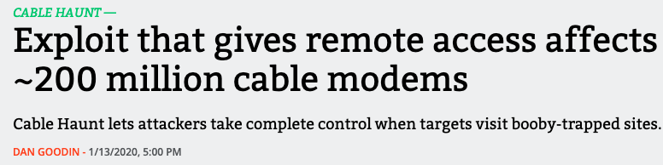
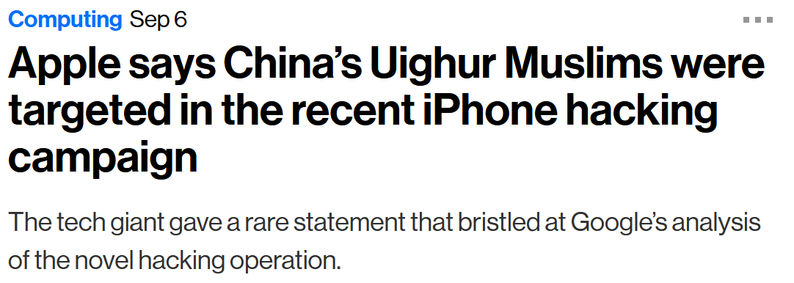
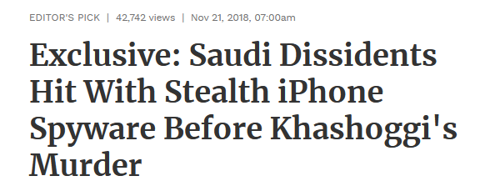
Memory safety is a serious problem!
Notes:
Many modern day security attacks are due to memory corruption vulnerabilities. They have very serious implications in the real world. Memory corruption vulnerabilities have existed for many years, yet they are still prevalent.

Slide 5
State-of-the-art memory corruption defenses
JOP
SROP
BOP
Smashing the stack
2011
2016
2019
Format String
Heap Spraying
Non-Control Data Attacks
DOP
1996
2008
Code Injection
Heap Overflows
Info. Leak
ROP
JIT-ROP
COOP
The First doc. Overflow Attack
1997
1998
2000
2001
2001
2003
2005
2007
2008
2014
2015
2016
2019
2021
1988
1997
1998
2000
2002
2004
2007
2013
2015
2016
Timeline
1972
Non
Executable Stack
Heap Mitigations
ASLR
CFI
Code Divers.
XnR
ARM MTE
2003
Format Guard
Point Guard
Shadow Stack
Code Pointer Integrity
Vtable Protection
NX-bit
VIP
2003
2016
2015
Stack Canaries
Instruction Set Random.
Runtime Divers.: Shuffler
Isomeron
Cryptographic-CFI
ARM PAC
2015
2018
Notes:
This slide summarizes the battle between attack and defense research regarding memory safety, from both academia and industry. As can be seen, it was 50 years ago when the first buffer overflow attack was documented. Then it went back and forth between attacks and defenses. Some of the most notable attacks are stack smashing and ROP which is Return oriented programming, and some of the most notable defenses are ASLR and CFI. By the way, VIP is one of my publications and it was published in CCS 2021.

Slide 6
State-of-the-art memory corruption defenses
JOP
SROP
BOP
Smashing the stack
2011
2016
2019
Format String
Heap Spraying
Non-Control Data Attacks
DOP
1996
2008
Code Injection
Heap Overflows
Info. Leak
ROP
JIT-ROP
COOP
The First doc. Overflow Attack
1997
1998
2000
2001
2001
2003
2005
2007
2008
2014
2015
2016
2019
2021
1988
1997
1998
2000
2002
2004
2007
2013
2015
2016
Timeline
1972
Non
Executable Stack
Heap Mitigations
ASLR
CFI
Code Divers.
XnR
ARM MTE
2003
Format Guard
Point Guard
Shadow Stack
Code Pointer Integrity
Vtable Protection
NX-bit
VIP
2003
2016
2015
Stack Canaries
Instruction Set Random.
Runtime Divers.: Shuffler
Isomeron
Cryptographic-CFI
ARM PAC
2015
2018
Notes:
Two of the most serious attacks are control flow hijacking attacks, in which the attacker violates the control-flow of the program and non-control data attacks, which are attacks that do not violate the control-flow of the program, and instead rely on manipulation of data variables in programs. Many defenses have been proposed over the years, with control-flow integrity, or CFI, being one of the most important ones to defend against control flow hijacking attacks. Recently, hardware vendors have started releasing hardware security features to help defend against these attacks, such as ARM Pointer Authentication Codes, or ARM PAC. The battle is still ongoing until today, with state-of-the-art defenses continuing to be proposed against these two attack avenues.

Slide 7




Challenges in the current state-of-the-art
Why are efficient and practical memory safety defense mechanisms hard to achieve?
Low coverage
Many moving parts make it difficult to cover all avenues
Less security guarantees
Modern attacks require more code components to be guarded
High Performance overhead
A defense mechanism needs to be sufficiently fast to be used in the real-world
Compatibility
Defense mechanisms must be compatible with current legacy code
Notes:
So what are the most pressing challenges in the current state-of-the-art defenses. Well the first is low coverage. Due to the existence of different attack types and avenues in a program, it is difficult for a defense mechanism to cover more than one. For example, return addresses and function pointers cannot be protected in the same way, and so some state-of-the-art defense mechanisms need to make a choice and compromise the others. Then there is less security guarantees. A defense may open an avenue for an attack. For example, many modern defenses rely on metadata in memory, and this opens an avenue for attackers to exploit that metadata and compromise the actual defense mechanism. Then one of the most prevalent reasons is high performance overhead. Due to the fact that extra checks are needed, for example, whenever a code pointer is dereferenced, these can build up for the whole program and cause the program to be much slower than without the defense mechanism. Thus, the checking needs to be fast and efficient which isn’t the case for most of the state-of-the-art. And finally, compatibility. Many defense mechanisms are not compatible with legacy code and need modifications or annotations done to the language to be able to implement the defense. Even though these challenges have improved over time, they still very much exist in many recent defense mechanisms.

Slide 8
Thesis Question
Is it possible to design an effective and practical defense mechanism to defend against memory corruption attacks by addressing the challenges above? If so, how?
Notes:
This brings us to the question of this thesis. Is it possible to design an effective and practical defense mechanism to defend against memory corruption attacks by addressing the challenges above? If so, how? Is it possible to address the challenges that we discussed in the previous slide?

Slide 9
Thesis Statement
Defense mechanisms against memory corruption attacks can be practical, efficient and have more coverage by utilizing hardware security and software codesign.
Notes:
And the answer is yes. This thesis attempts to address these challenges by designing powerful, practical and efficient defense mechanisms by leveraging hardware security features. Hardware security features here refers to certain security primitives implemented by hardware vendors, such as Intel and ARM, in their CPUs that can be utilized to build defense mechanisms that address these challenges. The insight here is that combining these hardware security primitives with software design can open new and practical defense avenues against a variety of attacks. However, they are just primitives and can’t be used naively. Thus, they need to be used alongside a practical design, which this thesis attempts to do.

Slide 10
Outline
Motivation
Background
Memory safety basics
Memory safety attacks
ARM Pointer Authentication
Past work: PACTight
Present Contributions
Future Work
Summary
Notes:
Now that we have explained the motivation
we can take a step back and go over the background for this thesis

Slide 11
Memory Safety definition
Memory safety means that memory objects are guaranteed to be accessed only:
Memory Object (A)
Pointer (A)
Virtual Memory
Notes:
Let’s start by defining what memory safety is. What we have here is a visualization of the virtual memory, with a memory object allocated and a pointer that points to it. Memory safety means that memory objects are guaranteed to be accessed only…

Slide 12
Memory Safety definition
Memory safety means that memory objects are guaranteed to be accessed only:
Between their intended bounds
Memory Object (A)
Pointer (A)
Virtual Memory
Notes:
…between their intended bounds, and this means that the pointer should not be allowed to access any memory region outside the allocated one.

Slide 13
Memory Safety definition
Memory safety means that memory objects are guaranteed to be accessed only:
Between their intended bounds,
During their lifetime,
Memory Object (A)
Pointer (A)
Virtual Memory
Notes:
Also, memory objects should only be accessed during their lifetime, and thus a pointer should not be allowed to access a memory object after it has been deallocated.

Slide 14
Memory Safety definition
Memory safety means that memory objects are guaranteed to be accessed only
Between their intended bounds,
During their lifetime,
Given their original (or compatible) type.
Memory Object (A)
Pointer (A)
Pointer (B)
Virtual Memory
Notes:
And finally, a memory object should only be accessed by a pointer of the same or compatible type. Thus, a pointer of type (B) should only be allowed to access an object of type (B) and not an object of type (A).

Slide 15
Memory Safety definition Violations
Memory safety means that memory objects are guaranteed to be accessed only:
Between their intended bounds,
During their lifetime,
Given their original (or compatible) type.
Memory Object (A)
Pointer (A)
Pointer (B)
Virtual Memory
Notes:
These are the rules, but attackers violate the rules. So how can these rules be violated?

Slide 16
Memory Safety definition Violations
Memory safety means that memory objects are guaranteed to be accessed only:
Between their intended bounds, Buffer overflow
During their lifetime,
Given their original (or compatible) type.
Notes:
Violating bounds can be done by a buffer overflow, in which an attacker stores more data in the buffer than its capacity, leading to an overflow that corrupts other data in memory. This is due to the fact that C and C++ semantics allow this type of behavior. If carefully corrupted, an attacker can execute extremely powerful attacks.

Slide 17
Memory Safety definition Violations
Memory safety means that memory objects are guaranteed to be accessed only:
Between their intended bounds, Buffer overflow
During their lifetime, Use-after-free
Given their original (or compatible) type.
Notes:
The next violation is a use-after-free violation. As the name suggests, this violation happens when an attacker uses a pointer to an object after the object has been freed.

Slide 18
Memory Safety definition Violations
Memory safety means that memory objects are guaranteed to be accessed only:
Between their intended bounds, Buffer overflow
During their lifetime, Use-after-free
Given their original (or compatible) type. Type confusion
Notes:
The last type of violation is a type confusion violation, in which the attacker uses a pointer of a different type to the object that they want to point to.

Slide 19
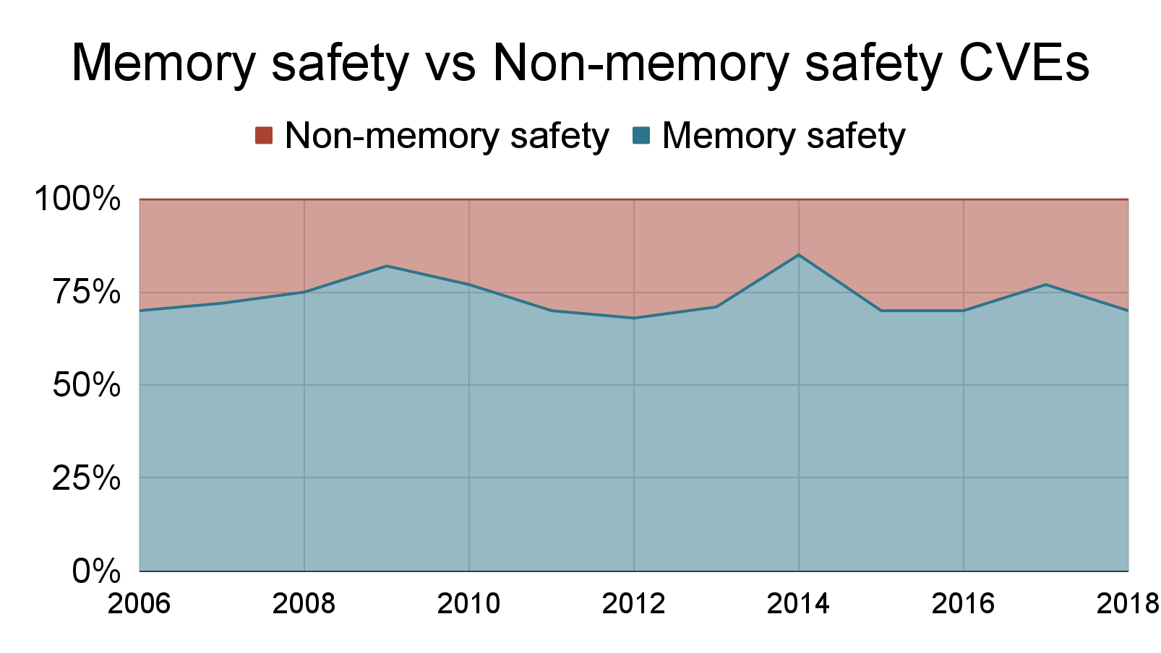
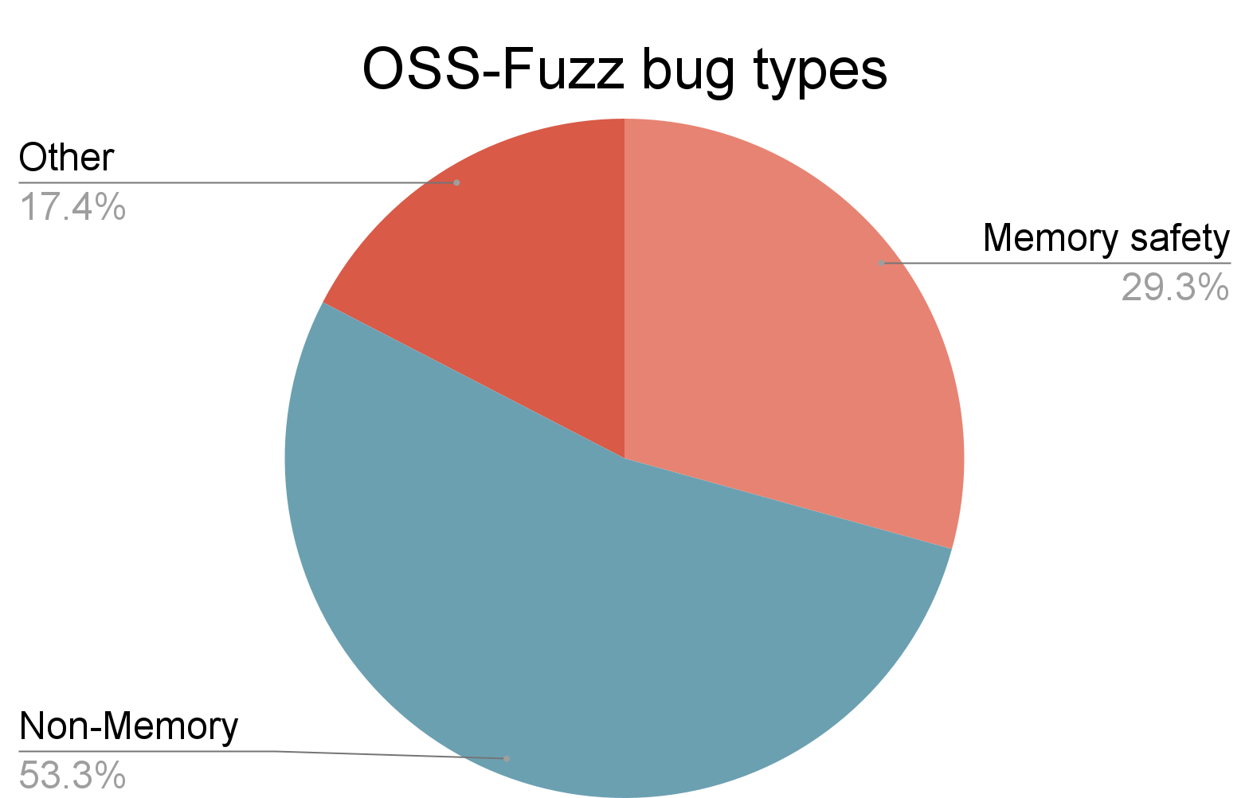
Memory safety is a serious problem!
Microsoft Product CVEs
Google OSS (Open Source Software) Fuzz bugs
https://www.zdnet.com/article/microsoft-70-percent-of-all-security-bugs-are-memory-safety-issues/
https://security.googleblog.com/2018/11/a-new-chapter-for-oss-fuzz.html
Notes:
As mentioned before, memory safety is a serious problem. Many of these violations are due to memory corruption vulnerabilities. In a study done by Microsoft on its products, they reported that 70% of all security bugs found were due to memory safety issues, and 30% of bugs in Google Open Source are memory safety bugs.

Slide 20

Control-flow hijacking and data-oriented attacks are critical!
Control-flow hijacking and data-oriented attacks are dangerous memory corruption attacks
SSL_CTX * ssl_ctx
BIGNUM * d1
BN_ULONG * d2
First Basic Block
Control-flow transfer
struct cert_st * cert
struct rsa_st * rsa
Private Key
Illegal control flow transfer
e.g., SYSTEM()!
CERT_PKEY * key
EVP_PKEY* privatekey
Adversary!
Control-flow hijacking
Data-oriented attack
Notes:
Here I will introduce two attacks based on violating memory safety: Control flow hijacking and data-oriented attacks. Control-flow hijacking attacks aim to maliciously change the legitimate control-flow of a program. This can be done by corrupting indirect calls or jumps, or return addresses. This allows the adversary to execute an illegitimate control-flow transfer, that can reach, for example, a system call. Data oriented attacks are similar in terms of the exploit mechanism, but they do not violate the control flow. Instead they abuse other non-control data such as data pointers and can be very dangerous resulting in, for example, leaking an SSL key. Data oriented attacks are much harder to defend against due to the abundance of data pointers in a program.

Slide 21
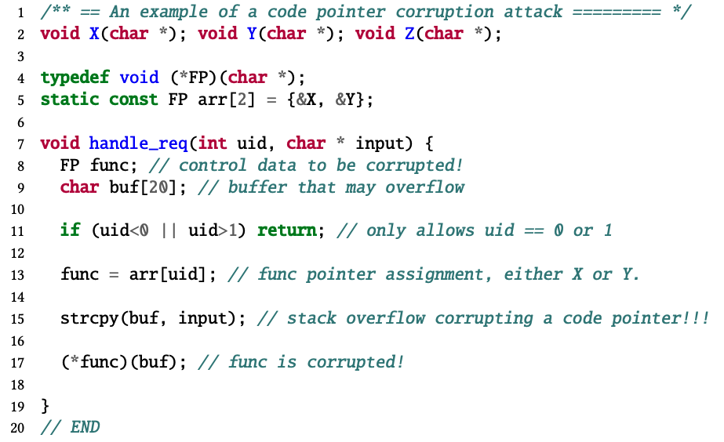
Vulnerable Control Data Example
stack
0x00
buf
Malicious ptr
func = &X
func
0xff
ret
Notes:
Here is a code example showcasing how an attacker can hijack the control flow of a program via a memory corruption vulnerability. The function handle_req allocates several variables on the stack, including a function pointer func. This function pointer is then assigned a legitimate value by the program. However, the strcpy function, immediately following the assignment, allows the attacker to overflow the buf buffer, and overwrite the function pointer value with a specially crafted malicious pointer. Then when the function pointer is dereferenced this can jump to some arbitrary code, such as a ROP chain for example, and execute malicious code.

Slide 22
ARM Pointer Authentication
Pointer Authentication Code (PAC) is generated by a cryptographic hash function.
The PAC is then placed on the unused bits of the 64-bit pointer.
Plaintext (Address)
Key
Hash
Salt
Hashed Text (PAC)
40-bits
Address
PAC
64-bits
Notes:
To help combat abusing pointers, ARM released a hardware security feature called Pointer Authentication. Pointer Authentication relies on utilizing the unused bits of a 64-bit pointer to store a Pointer Authentication Code or PAC that is generated by a cryptographic hash function. This PAC cannot be calculated without a secret key. This allows the pointer to be signed by this PAC, and thus the PAC needs to be properly removed, or authenticated, before the pointer can be used.

Slide 23


ARM Pointer Authentication
PAC signing: The algorithm takes the pointer and modifier, as well as a key, and generates a PAC.
PAC authentication: The algorithm takes the pointer with the PAC and the modifier. The PAC is then regenerated and compared with the one on the passed pointer.
Address
Address
PAC
Secret Key
Cryptographic algorithm
Modifier
Secret Key
Cryptographic algorithm
Modifier
Key
Hash
Salt
Key
Hash
Salt
Address
PAC
Address
Notes:
So how does this mechanism work? There are two main primitives. The first is the signing of the pointer. A cryptographic hash algorithm takes a secret key, a pointer and the modifier, which is provided by the program. The secret key is initialized by the kernel and stored in a register. The algorithm then computes the PAC, and places it on the top of the pointer. Then when a pointer needs to be authenticated, the algorithm takes the same inputs again and regenerates the PAC. If the PAC matches, then the PAC is removed from the pointer and the pointer can be used.

Slide 24

ARM Pointer Authentication
PAC signing: The algorithm takes the pointer and modifier, as well as a key, and generates a PAC.
PAC authentication: The algorithm takes the pointer with the PAC and the modifier. The PAC is then regenerated and compared with the one on the passed pointer.
Address
Address
PAC
Secret Key
Cryptographic algorithm
Modifier
Secret Key
Cryptographic algorithm
Modifier
Key
Hash
Salt
Key
Hash
Salt
Address
PAC
Address
0x2
Notes:
However, if the authentication fails, the top two bits of the pointer are flipped, thus rendering the pointer to be unusable. Any change in any of the components passed to the cryptographic algorithm will result in a different PAC and thus a failed authentication.

Slide 25
Outline
Motivation
Background
Memory safety basics
Memory safety attacks
ARM Pointer Authentication
Past work: PACTight
Present Contributions
Future Work
Summary
Notes:
Let’s now focus on one of my past works, called PACTight. I wish to clarify that I did this work during the course of my PhD but since I used it in my Masters thesis, I have it here in the background. But it is an important part of the overall story of my thesis.

Slide 26



Limitations of state-of-the-art PAC techniques
Reliance on a modifier that can be repeated, thus attackers can reuse the PAC generated for one in the context of using the other. [PARTS-CFI SEC’19]
Reliance on the presence of a forward-edge CFI technique with the PAC defense mechanism. [PACStack SEC’21]
Constrained threat model, defending only against attackers with just arbitrary write. The defense is not effective if the attacker has arbitrary read.
[PTAuth SEC’21]
Notes:
So let’s start of by focusing on specific limitations of defenses that have actually used Pointer Authentication. There are limitations present in the current state-of-the-art. One limitation is reliance on a modifier that can be repeated. This means attackers can reuse the PACs that are generated. Another limitation is needing a forward edge CFI technique to be present, so that the attacker cannot skip the instrumentation. Another limitation of some techniques is the reliance on a weaker threat model with only arbitrary write. The attacker must not have arbitrary read for the defense to be viable. There are many limitations in the current state-of-the-art with plenty of room for improvement.

Slide 27


PACTight Overview
We define three security properties of a pointer such that, if achieved, prevent pointers from being tampered with.
Unforgeability: A pointer should always point to its legitimate object.
Non-copyability: A pointer can only be used when it is at its specific legitimate location.
Non-dangling: A pointer cannot be used after its object has been freed.
Notes:
Based on the limitations I mentioned, we identified three security properties in pointers that, if enforced, completely protect pointers from being abused.

Slide 28
PACTight Overview
We define three security properties of a pointer such that, if achieved, prevent pointers from being tampered with.
Unforgeability: A pointer should always point to its legitimate object.
Non-copyability: A pointer can only be used when it is at its specific legitimate location.
Non-dangling: A pointer cannot be used after its object has been freed.
Notes:
They are unforgeability, in which a pointer must always point to its legitimate object,

Slide 29
PACTight Overview
We define three security properties of a pointer such that, if achieved, prevent pointers from being tampered with.
Unforgeability: A pointer should always point to its legitimate object.
Non-copyability: A pointer can only be used when it is at its specific legitimate location.
Non-dangling: A pointer cannot be used after its object has been freed.
Notes:
non-copyability, meaning a pointer can’t be used at a location other than its legitimate one,

Slide 30
PACTight Overview
We define three security properties of a pointer such that, if achieved, prevent pointers from being tampered with.
Unforgeability: A pointer should always point to its legitimate object.
Non-copyability: A pointer can only be used when it is at its specific legitimate location.
Non-dangling: A pointer cannot be used after its object has been freed.
Notes:
and finally non-dangling, meaning a pointer cannot be used after its object has been freed. Enforcing these three properties tightly seals the pointers from illegal use.

Slide 31
Introducing PACTight
The three properties:
Notes:
Let’s take a closer look at the three properties to better define them.

Slide 32
Introducing PACTight
The three properties:
Pointer
Object
Forged Pointer
Object
Another object
Pointer is corrupted
Forgeability
Notes:
Foregability means that a pointer that points to a specific object becomes corrupted with a forged pointer to point to another object.

Slide 33
Introducing PACTight
The three properties:
Pointer
Object
Pointer
Object
Forged Pointer
Object
Pointer
Object
Another object
Copied Pointer
Pointer is harvested and copied
Pointer is corrupted
Forgeability
Copyability
Notes:
Copyability means that a maliciously copied pointer can still be legitimately used to point to an object.

Slide 34
Introducing PACTight
The three properties:
Pointer
Object
Pointer
Object
Pointer
Object
Pointer use after free
Forged Pointer
Object
Pointer
Object
Pointer
Freed object
Another object
Copied Pointer
or
Pointer is harvested and copied
Pointer
Realloc’d object
Pointer is corrupted
Forgeability
Copyability
Dangling
Notes:
Dangling means that the pointer of a freed or realloc’d object still points to that object and can be abused by an attacker.

Slide 35
Introducing PACTight
The three properties:
Pointer
Object
Pointer
Object
Pointer
Object
Pointer use after free
Forged Pointer
Object
Pointer
Object
Pointer
Freed object
Another object
Copied Pointer
or
Pointer is harvested and copied
Pointer
Realloc’d object
Pointer is corrupted
Forgeability -> Generating valid PAC
Copyability -> Reuse valid pointer
Dangling -> Reuse invalid pointer
Notes:
Powerful memory corruption attacks are a direct implication of violating these three properties. An attacker can generate valid PACs with forgeability, reuse valid pointers with copyability, and reuse invalid pointers with dangling.

Slide 36

Introducing PACTight: Goal
The importance of these properties stems from the fact that to hijack control-flow, at least one of these properties must be violated.
PACTight tightly seals pointers and guarantees that a sealed pointer cannot be forged, copied, and is not dangling.
PACTight overcomes the limitations of previous approaches:
The non-copyability property prevents any PAC reuse.
PACTight protects all globals, stack variables and heap variables.
PACTight assumes a strong threat model that has both arbitrary read and write capabilities.
Notes:
The importance of these properties stems from the fact that, in order to hijack control-flow, at least one of these properties must be violated, based on our analysis. And so, PACTight seals pointers and guarantees that they cannot be misused. PACTight also overcomes the limitations of previous approaches. The non-copyability property prevents any PAC reuse. PACTight protects all globals, stack variables and heap variables. PACTight assumes a strong threat model with arbitrary read and write capabilities

Slide 37


PACTight Design: Enforcing the properties
In order to enforce the three properties, PACTight relies on the PAC modifier.
Any changes in either the modifier or the address result in a different PAC, detecting the violation.
Notes:
So how will PACTight enforce the three properties? PACTight relies on the pointer authentication modifier. This modifier is used by the cryptographic hash algorithm to generate the PAC. The reason we rely on it is that it is user-controlled and can be made complex enough to generate a unique PAC. Any modification to it or the pointer would result in a violation

Slide 38
PACTight Design: Enforcing the properties
We propose to blend the address of a pointer (&p) and a random tag associated with a memory object (tag(p)) to efficiently enforce the PACTight pointer integrity property
Notes:
PACTight blends the address of the pointer (ampersand p) and a unique random tag, generated by the PACTight compiler and associated with the memory object, to enforce the three properties.

Slide 39
PACTight Design: Enforcing the properties
We propose to blend the address of a pointer (&p) and a random tag associated with a memory object (tag(p)) to efficiently enforce the PACTight pointer integrity property
Address
Secret Key
Cryptographic algorithm
Modifier
&p ⨁ tag(p)
Address
PAC
Signing
Notes:
For signing, we incorporate these elements into the modifier, so the cryptographic algorithm modifier is the location of the pointer and the tag,

Slide 40
PACTight Design: Enforcing the properties
We propose to blend the address of a pointer (&p) and a random tag associated with a memory object (tag(p)) to efficiently enforce the PACTight pointer integrity property
Address
Address
PAC
Secret Key
Cryptographic algorithm
Modifier
&p ⨁ tag(p)
Secret Key
Cryptographic algorithm
Modifier
&p ⨁ tag(p)
Address
PAC
Address
Signing
Authentication
Notes:
and the same way for authentication, as can be seen, to regenerate the PAC successfully. I’ll explain now how this choice enforces the three properties.

Slide 41


PACTight Design: Enforcing the properties
Non-copyability: PACTight adds the location of the pointer (&p) as part of the modifier. Any change in the location by copying the pointer triggers an authentication fault.
Pointer
Object
Forged Pointer
Object
Copied Pointer
Pointer (p)
Copied Pointer (q = p)
Authenticate
Authenticate
Address
PAC
Address
Address
PAC
Address
0x2
Modifier
&p ⨁ tag(p)
Modifier
&q ⨁ tag(q)
Object
Object
&q != &p
Notes:
Due to time constraints, I will only go through the detailed enforcement of one of the properties. For non-copyability, the location of the pointer being included as a part of the modifier means that any copied pointer will generate a different PAC on authentication, due to a different ampersand p, thus resulting in mismatch on authentication. This means that a pointer can only be used in its legitimate location, enforcing the second property.

Slide 42
PACTight Defense Mechanisms
The PACTight compiler automatically instruments all globals, stack variables and heap variables in a program, inserting the necessary PACTight APIs.
We implement four defense mechanisms:
Control-Flow Integrity (forward edge protection)
C++ VTable pointers protection
Code Pointer Integrity (all sensitive pointer protection) [Kuznetsov et. al, OSDI 2014]
Return address protection (backward edge protection)
Notes:
PACTight can be easily applied to protect a variety of pointer types. The PACTight compiler automatically instruments all globals, stack and heap variables. We chose to implement four PACTight defense mechanisms to demonstrate PACTight’s versatility and coverage.

Slide 43
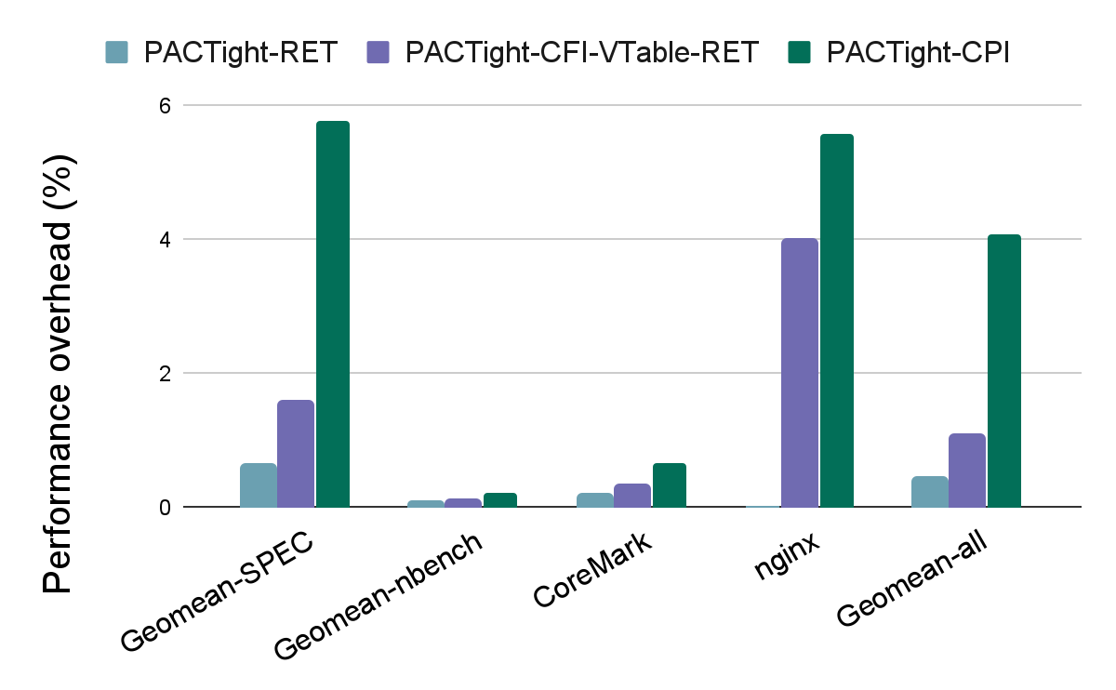
Evaluation: Performance overhead
Geometric mean:
0.43% for PACTight-RET
1.09% for PACTight-CFI+VTable+RET
4.07% for PACTight-CPI
Notes:
We ran PACTight with three sets of benchmarks, the SPEC CPU2006 set, the nbench set and CoreMark. We also ran one real-world application, nginx, which is a web server. The following graph shows our numbers for the different PACTight defense mechanisms. As can be seen, PACTight has low average overhead.

Slide 44
Summary and limitations
PACTight is an efficient and robust mechanism utilizing ARM’s PA mechanism.
Three security properties that PACTight enforces to ensure pointer integrity.
PACTight is secure against real and synthesized attacks (more details in the paper) and has low performance and memory overhead
Published in USENIX Security 2022
Limitations:
Does not protect data pointers.
The existence of the external metadata adds overhead and possible security risks.
Notes:
So to conclude this chapter, I have introduced PACTight, which is an efficient and robust mechanism that utilizes ARM’s pointer authentication primitives to guarantee pointer integrity. We identified three security properties that PACTight enforces and did an extensive evaluation. PACTight was published in USENIX Security 2022. However, it does have some limitations. It doesn’t cover data pointers, which are a dangerous attack avenue as mentioned before, and the existence of the external metadata adds overhead due to the metadata lookup, and it is also only protected by ASLR and thus exposed to the attacker. So these limitations need to be addressed and are addressed in this thesis in the next contribution.

Slide 45
Summary and limitations
PACTight is an efficient and robust mechanism utilizing ARM’s PA mechanism.
Three security properties that PACTight enforces to ensure pointer integrity.
We implemented PACTight with four defense mechanisms, protecting forward-edge, backward-edge, virtual function pointers, and sensitive pointers.
PACTight is secure against real and synthesized attacks (more details in the paper) and has low performance and memory overhead
Published in USENIX Security 2022
Limitations:
Does not protect data pointers.
The existence of the external metadata adds overhead and possible security risks.
Notes:
So to conclude this chapter, I have introduced PACTight, which is an efficient and robust mechanism that utilizes ARM’s pointer authentication primitives to guarantee pointer integrity. We identified three security properties that PACTight enforces. We showcased PACTight with four defense mechanisms that protect a wide variety of security-sensitive pointers. We evaluated PACTight against real-world and synthesized attacks, more details on those in the paper, and showcased its low overhead on a variety of benchmarks and using real PAC instructions. PACTight was published in USENIX Security 2022. However, it does have some limitations. It doesn’t cover data pointers, which are a dangerous attack avenue as mentioned before, and the existence of the external metadata adds overhead due to the metadata lookup, and it is also only protected by ASLR and thus exposed to the attacker. So these limitations need to be addressed and are addressed in this thesis in the next contribution.

Slide 46
Outline
Motivation
Background
Present Contributions
Runtime Scope Type Integrity (RSTI)
Future Work
Summary
Notes:
So now we have gone over the motivation and background for this work,
Next we will dive into the present contributions of this thesis.

Slide 47


Data oriented attacks are becoming more sophisticated!
A new breed of attacks has emerged in recent years that doesn’t violate control-flow.
Attacks such as DOP and NEWTON exploit data pointers to leak sensitive data, such as SSL keys, or achieve arbitrary code execution.
Notes:
We talked in the background about data-oriented attacks, and these attacks are becoming more and more sophisticated. As control-flow hijacking defenses become better, attackers have looked for other attack avenues to execute their attacks. This resulted in complicated attacks such as Data Oriented Programming, or DOP, and NEWTON, in which they leak SSL keys and achieve arbitrary code execution without violating control flow.

Slide 48



Current data-oriented defense mechanisms are limited!
Data Flow Integrity (DFI) makes sure that a variable can only be written by its legitimate write instruction.
Complete DFI incurs around 103% runtime overhead on average and 50% memory overhead, which is very high.
Hardware assisted Data Flow Isolation (HDFI) provides instruction-level isolation by relying on tags.
However, HDFI relies on a 1-bit tag, and thus only two protection domains.
YARRA is an extension of the C language that relies on programmer annotations to protect critical data types marked by the developer.
Performance overhead is variable, but when applied to the whole program, the runtime overhead is in the order of more than 400%. In addition to that, coverage is limited.
Notes:
Of course, there are defenses against data oriented attacks, but they suffer from many challenges. One of them is Data Flow Integrity or DFI, which conforms each variable to its legitimate write instruction. However, the performance penalty is quite high, incurring an average of 103% runtime overhead and 50% memory overhead. Another mechanism is Hardware assisted Data Flow isolation or HDFI, which isolates instructions based on a one bit tag, offering a protected and unprotected domain. However, this is very coarse grained, and thus the security guarantees are not very high. YARRA relies on programmer annotations that are marked by the developer through an extension to the C language. However, YARRA suffers from an average runtime overhead of approximately 400% when applied to the whole program. As can be seen, current data-oriented defense mechanisms have many limitations that need to be addressed.

Slide 49

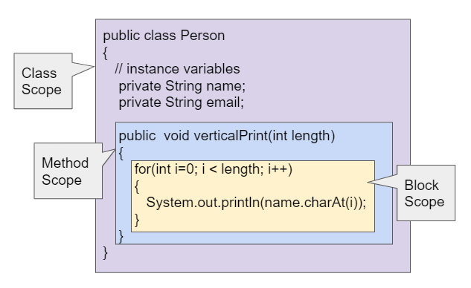

The programmer expresses intent when writing a program
When a programmer writes a C/C++ program, each defined variable has a few properties. Some of these are:
Basic Type: Each variable must have a specific type, e.g., char, int*.
Scope: Scope defines where the variable will be used.
Permission: We refer to permissions as whether a variable is defined as read or read/write.
Notes:
So let’s take a step back and look at what defense mechanisms want to achieve. The goal of the defense mechanisms is ensuring correct and proper execution of a program. Meanwhile, the developer of the program has put much information whilst they were writing the program to make sure that it executes in a certain way. All this information is, unfortunately, lost at runtime. So why not use this information as the security context that we need, and propagate it to the runtime in some way? If we can ensure that the program executes in the way that the developer intended even when an attacker is present, then the program would not be compromised, since an attacker relies on the anomalous execution of a program by exploiting vulnerabilities. However, this information needs to be carefully chosen, in order to guarantee enough uniqueness of the security context between different pointers. We identified three main vital pieces of information, that are defined by a developer to execute the program correctly and these are …..

Slide 50
The programmer expresses intent when writing a program
When a programmer writes a C/C++ program, each defined variable has a few properties. Some of these are:
Basic Type: Each variable must have a specific type, e.g., char, int*.
Scope: Scope defines where the variable will be used.
Permission: We refer to permissions as whether a variable is defined as read or read/write.
Notes:
… the basic type of a variable, e.g., char, int*. This type is defined by the developer to tell the compiler how this variable will be used in the program

Slide 51
The programmer expresses intent when writing a program
When a programmer writes a C/C++ program, each defined variable has a few properties. Some of these are:
Basic Type: Each variable must have a specific type, e.g., char, int*.
Scope: Scope defines where the variable will be used.
Permission: We refer to permissions as whether a variable is defined as read or read/write.
Notes:
… the scope which defines where the variable should be used legitimately

Slide 52
The programmer expresses intent when writing a program
When a programmer writes a C/C++ program, each defined variable has a few properties. Some of these are:
Basic Type: Each variable must have a specific type, e.g., char, int*.
Scope: Scope defines where the variable will be used.
Permission: We refer to permissions as whether a variable is defined as read or read/write.
Notes:
… and the permission, and we refer to permissions as whether a variable is defined as read or read/write. These three properties express what the developer’s intent is for the usage of variables

Slide 53


The programmer expresses intent when writing a program
Programmer intent gets lost at runtime!
What if we bring back the programmer’s intent to the runtime?
Notes:
However, such information is lost after compilation, and thus the programmer’s intent gets translated to just raw addresses. Thus, an attacker can easily weaponize pointers without conforming to their proper usage. What if we bring back that information, and enforce the program to conform to it at runtime? Then, the program can be executed in the proper programmer-intended manner, leaving little room for attackers to manipulate the program.

Slide 54

Scope-Type Integrity (STI)
A new defense policy that enforces pointers to conform to the programmer’s intended manner, by utilizing scope, type, and permission information.
This allows STI to defeat advanced pointer attacks since these attacks typically violate either the scope, type, or permission.
Notes:
To this end, I propose Scope-Type Integrity (STI), a new defense policy that enforces pointers to conform to the programmer’s intended manner, by utilizing scope, type, and permission information. STI collects information offline about the type, scope, and permission (read/write) of every pointer in the program. STI ensures that pointers are always dereferenced from the correct scope, with the correct type and correct permissions. This information can then be used at runtime to ensure that pointers comply with their intended purpose, and allows STI to defeat advanced pointer attacks since these attacks typically violate either the scope, type, or permission.

Slide 55

Runtime Scope-Type Integrity (RSTI)
RSTI leverages ARM Pointer Authentication (PA) to generate Pointer Authentication Codes (PACs), based on the information from STI, and place these PACs at the top bits of the pointer.
At runtime, the PACs are then checked to ensure pointer usage complies with STI.
Notes:
I also present Runtime Scope-Type Integrity (RSTI), which is the implementation of STI. RSTI leverages ARM Pointer Authentication (PA) to generate Pointer Authentication Codes (PACs), based on the information from STI, and place these PACs at the top bits of the pointer. At runtime, the PACs are then checked to ensure pointer usage complies with STI. In this way, pointers are guaranteed to execute in the manner specified by the programmer in the application. This allows integrity checks to be performed without needing much external metadata and provides high-security guarantees against creative attacks. Also, leveraging ARM PA allows runtime checks to be efficient, thus opening the way to efficiently and securely protect all pointers in a program.

Slide 56
RSTI: Design goals
The main goal of RSTI is to protect all pointers in a program from memory corruption attacks.
In summary, our main goals are:
Completeness: Protection of all pointers in a program.
Little reliance on external metadata: Eliminate metadata lookup overhead and attacks on the metadata.
High performance: Keep runtime overhead as low as possible.
Compatibility: Allow protection of legacy (C/C++) programs without needing programmer annotations.
Notes:
The main goal of RSTI is to protect all pointers in a program from memory corruption attacks. This puts RSTI in a position similar to Data Flow Integrity (DFI) and other similar techniques. In summary, RSTI’s main goals are: • Completeness: Protection of all pointers in a program. • Little reliance on external metadata: Eliminate metadata lookup overhead and attacks on the metadata. • High performance: Keep runtime overhead as low as possible. • Compatibility: Allow protection of legacy (C/C++) programs without needing programmer annotations.

Slide 57
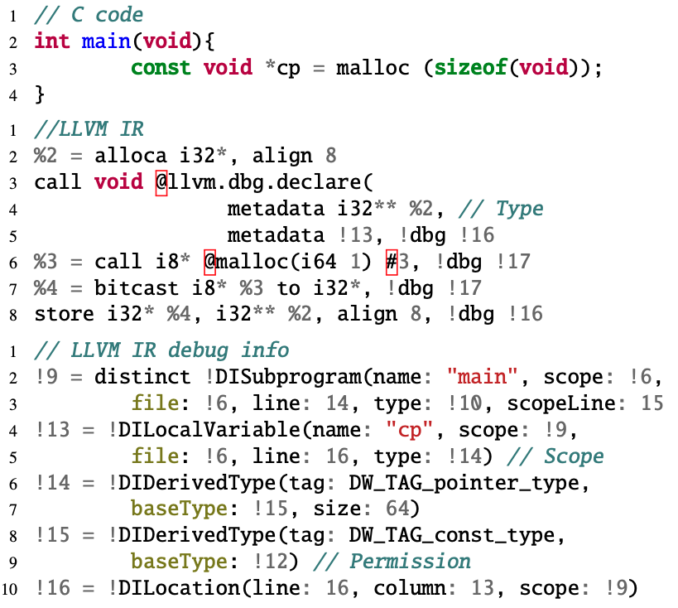
RSTI: Extracting scope, type and permission
LLVM Intermediate Representation (IR)
LLVM debug metadata
Notes:
So let’s take a closer look at how we extract this information, which I will refer to as scope-type information. We use the LLVM compiler infrastructure. LLVM’s Intermediate Representation (IR) allows us to obtain all of the scope-type information with LLVM’s IR metadata. LLVM generates llvm.dbg instructions, that can be used to access the metadata of the variable. STI uses these instructions to initialize the internal static metadata with the scope, type, and permission information. This code snippet shows a C program and the corresponding LLVM debug metadata.

Slide 58
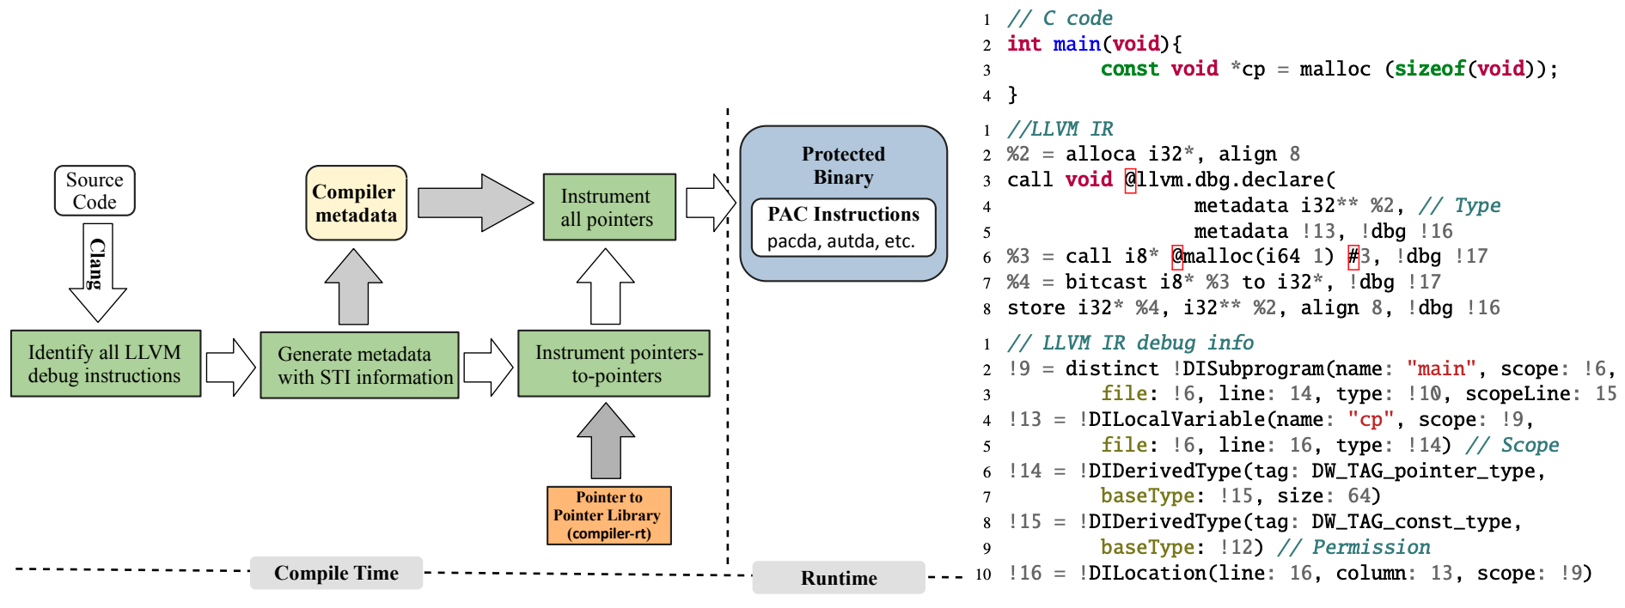
RSTI: Overview
Notes:
And here we see an overview of how RSTI works. First, the LLVM debug instructions are identified from the source code in the RSTI LLVM pass. Then, the scope-type information is extracted and added to an internal static compiler data structure. This is then used to instrument all pointers with the appropriate scope-type information included in the modifier of the PAC. RSTI also does special instrumentation for specific pointers to pointers, which I will get to explain in detail in the later slides. After all the instrumentation is done, we have a protected binary with all the pointers being protected to enforce the proper scope-type information.

Slide 59
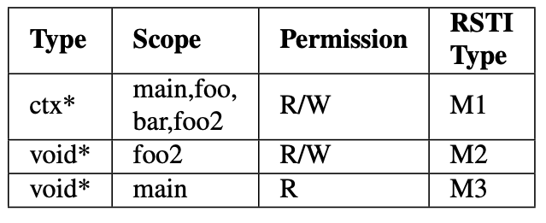
RSTI Type
A pointer type which restricts a pointer to conform to the scope-type information. If a pointer does not have the intended RSTI-type, RSTI will detect that the pointer has been tampered with.
RSTI is enforced with ARM’s Pointer authentication by adding the RSTI-type to the modifier.
Address
Secret Key
Cryptographic algorithm
Modifier
Key
Hash
Salt
Address
PAC
Notes:
Combining the scope-type information together, we produce what we refer to as the RSTI-type. We define RSTI-type as a pointer type which restricts a pointer to conform to the scope-type information. If a pointer does not have the intended RSTI-type, RSTI will detect that the pointer has been tampered with. For example, the table below shows two RSTI-types (M2 and M3) for one basic type (void*), due to the fact that there are two void* variables that have different scopes and different permissions. This also applies to local and escaping variables. RSTI instruments all pointer load/store instructions and enforces RSTI-type with PAC. RSTI instruments all pointers on the stack, heap, and globals. This mechanism allows STI’s restrictions to be enforced at runtime.

Slide 60
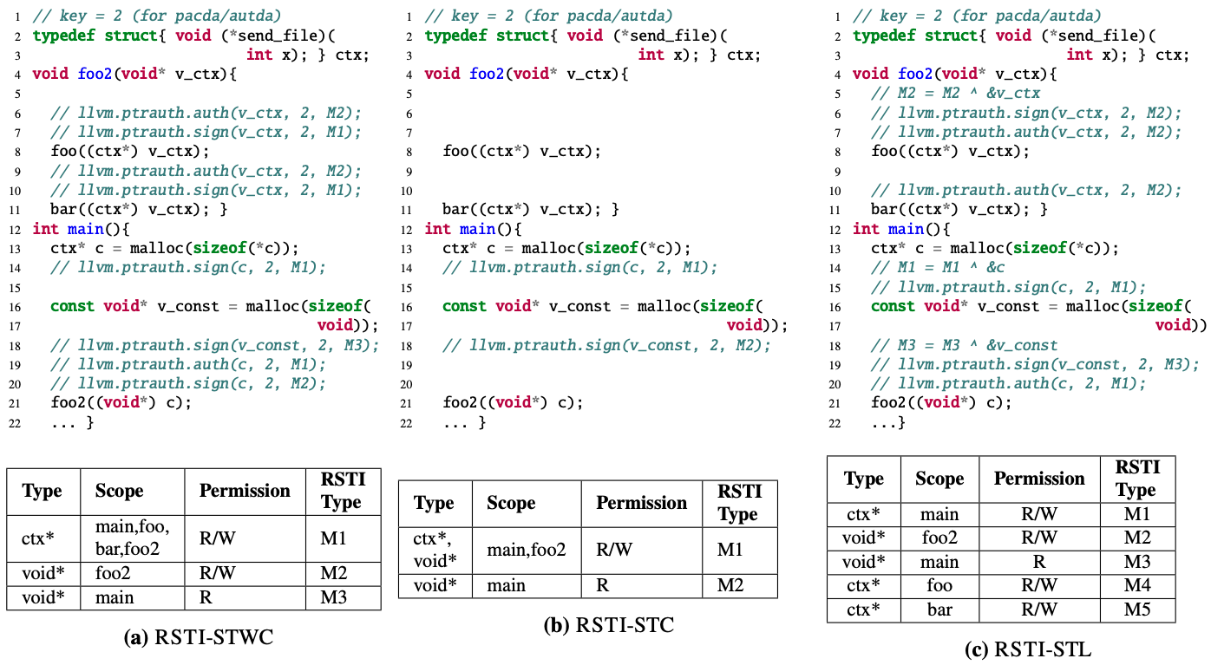
Enforcing RSTI-type
Three RSTI-types from two basic types.
Distinguish based on scope, type and permission.
Referred to as RSTI-STWC (Scope-Type Without Combining).
Authenticate and resign at casts.
Notes:
So what exactly does this entail? So this figure shows code instrumented with RSTI and the corresponding RSTI-types. In this example, there are two basic types in the program (void* and ctx*). Due to RSTI’s analysis considering scope and permission, there are now three RSTI-types, M1, M2 and M3. Whenever a cast happens between types, RSTI identifies that and authenticates the pointer and resigns it with the casted type. We refer to enforcing RSTI in this way as RSTI Scope-Type without combining, or RSTI-STWC. Even though there is a cast between void* and ctx*, RSTI-STWC maintains separate RSTI-types for them and distinguishes the permission in the void* basic type. RSTI-STWC makes sure that legitimate casts are handled appropriately by re-signing the PAC with the RSTI-types after casting, as in Lines 19-21 in the Figure.

Slide 61
RSTI Enforcement details
LLVM pointer authentication intrinsics
RSTI instruments all pointer loads/stores with PA instructions (pac/aut), leveraging LLVM’s pointer authentication intrinsics (llvm.ptrauth)
On-Store Pointer Signing
RSTI instruments all pointer stores in a program. They are all signed with their respective RSTI-type as the modifier.
On-Load Pointer Authentication
RSTI authenticates pointers as they are loaded from memory, using the same RSTI-type that was used to sign them on-store.
Notes:
So let’s talk about some enforcement details. RSTI instruments all pointer loads/stores with Pointer authentication instructions, utilizing LLVM’s pointer authentication intrinsics. These are internal compiler intrinsics that allow pointer authentication instructions to be added without needing an external library or inline assembly, and allow more optimizations for the compiler. RSTI instruments all pointer stores in a program. They are all signed with their respective RSTI-type as the modifier. Thus, all pointers in a program always have a PAC on them and are always protected. RSTI authenticates pointers as they are loaded from memory, using the same RSTI-type that was used to sign them on-store. The LLVM pointer authentication intrinsics allow authentication to happen without spilling to memory, due to them being optimized in the compiler. This means that we do not need to re-sign pointers after authentication, since the compiler optimizes the memory accesses and the authenticated address is always in a register.

Slide 62
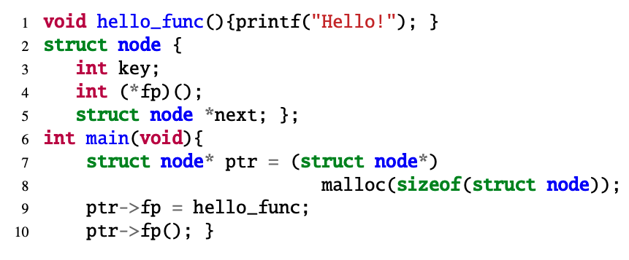
RSTI Enforcement details
Field sensitive analysis: RSTI handles members of a composite type and assigns the scope and type appropriately.
Type: struct node*
Scope: main
Notes:
RSTI does field-sensitive analysis on composite type variables in order to achieve finer-grained and accurate enforcement of the programmer’s intent. RSTI handles members of a composite type and assigns the scope and type appropriately. This code snippet shows an example of a variable ptr, which is of type struct node* and its scope is main.

Slide 63
RSTI Enforcement details
Field sensitive analysis: RSTI handles members of a composite type and assigns the scope and type appropriately.
Type: int()*
Scope: main, struct node*
Notes:
Its member variable, fp, has a type of int()* but its scope is both main as well as struct node. RSTI enforces that the ptr->fp() has the proper scope in terms of the functions it is executed in, as well as its composite type. Note that composite types can act as both scope and type, depending on which pointers are being referred to.

Slide 64
RSTI Enforcement details: Pointer-to-pointer handling
Due to the reliance on the RSTI-type when signing/authenticating pointers, we must make sure that the correct types are being used and propagated. For single pointers, this is not an issue.
However, for a pointer-to-pointer, this can be a possible issue, as the original type of the pointer can be lost, especially when the double pointer is casted and passed as a function argument.
Thus, we need to find a way to preserve the original type of the pointer in order to make sure that it does not violate the programmer’s intent.
Notes:
One important enforcement detail is handling pointers-to-pointers. Due to the reliance on the RSTI-type when signing/authenticating pointers, we must make sure that the correct types are being used and propagated. For single pointers, this is not an issue. However, for a pointer-to-pointer, this can be a possible issue, as the original type of the pointer can be lost, especially when the double pointer is casted and passed as a function argument. Thus, we need to find a way to preserve the original type of the pointer in order to make sure that it does not violate the programmer’s intent.

Slide 65
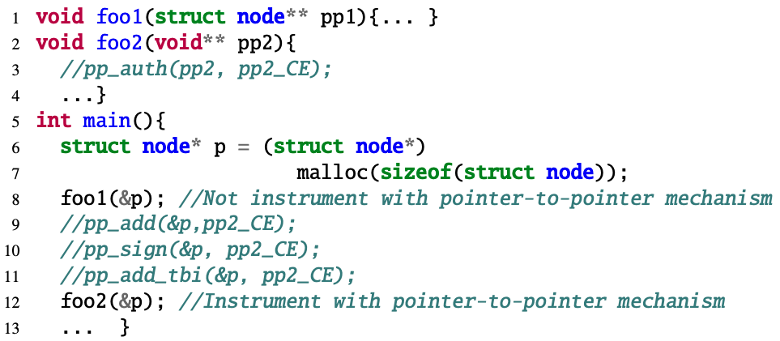
RSTI Enforcement details: Pointer-to-pointer handling
Notes:
Let’s clarify this with a code-snippet.

Slide 66
RSTI Enforcement details: Pointer-to-pointer handling
Notes:
Functions foo1 and foo2 take &p, a pointer-to-pointer, as an argument.

Slide 67
RSTI Enforcement details: Pointer-to-pointer handling
Notes:
For foo1, the same basic type (struct node) is in the argument and thus the pointer-to-pointer mechanism is not needed.

Slide 68
RSTI Enforcement details: Pointer-to-pointer handling
Notes:
However, for foo2, the type is void**. In this case, the original type (struct node**) is lost and thus the mechanism is needed

Slide 69
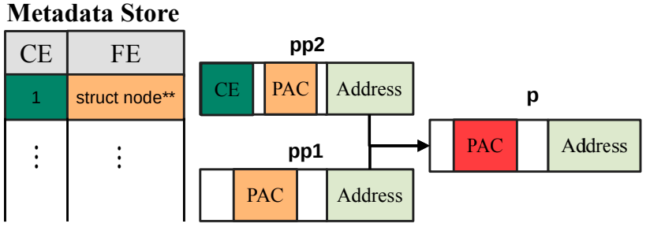
RSTI Enforcement details: Pointer-to-pointer handling
Store the original type on the pointer itself.
RSTI makes use of an ARMv8 hardware feature called Top Byte Ignore (TBI) that ignores the top 8 bits of a virtual address.
The tag and the full original type are referred to as the Compact Equivalent (CE) and Full Equivalent (FE), respectively.
Notes:
We resolve this by adding an extra step of indirection. We define a tag that gets added to the top bits and that leads us to the full original type along with its modifier from the RSTI-type. The tag and the full original type are referred to as the Compact Equivalent (CE) and Full Equivalent (FE), respectively. RSTI makes use of an ARMv8 hardware feature called Top Byte Ignore (TBI) that ignores the top 8 bits of a virtual address. Thus, RSTI stores a tag (CE) that refers to the original type (FE) on the top 8 bits of the pointer. The CE and FE are also both stored in read-only metadata in memory and can only be accessed by the pointer-to-pointer library.

Slide 70
RSTI Enforcement details: Pointer-to-pointer handling
Not all pointer-to-pointer types are covered. Only ones that are lost when the pointer type goes out of scope.
The IR provides sufficient information to handle pointer-to-pointer cases that do not fall into this category.
Notes:
Not all pointer-to-pointer types are covered. Only ones that are lost when the pointer type goes out of scope, (e.g., , being casted and passed as a function argument) and thus cannot be statically detected. While there are different pointer-to-pointer scenarios, few pointer-to-pointers fall into this specific category. The IR provides sufficient information to handle pointer-to-pointer cases that do not fall into this category. Thus, we do not need to instrument every pointer-topointer with this mechanism. Since the CE can only be 8 bits, this means that only 256 types can be used. This is shown to be sufficient in the evaluation section.

Slide 71
Other RSTI defense mechanisms
Three RSTI defense mechanisms, each with its own distinct view of the RSTI-type:
RSTI-STWC (Scope-Type Without Combining) authenticates and re-signs pointers when casts happen.
RSTI-STC (Scope-Type with Combining) combines compatible types together so that it wouldn’t need to re-sign pointers when pointer casts happen.
RSTI-STL (Scope-Type with Location) combines the location, i.e., address, of the pointer (&p) with the scope-type information.
Notes:
We implemented two other RSTI defense mechanisms in order to balance options for performance and security guarantees. RSTI’s three security mechanisms have different security guarantees due to the different nature and strictness each mechanism has to offer. I had previously explained our main mechanism RSTI-STWC, which authenticates and re-signs pointers when casts happen. RSTI-STC (Scope-Type with Combining) combines compatible types together so that it wouldn’t need to re-sign pointers when pointer casts happen. RSTI-STL (Scope-Type with Location) is the strictest RSTI defense mechanism. It combines the location, i.e., address, of the pointer with the scope-type information to completely prevent any pointer substitution attacks. This means that the pointer can only be used legitimately at that specific location.

Slide 72
Other RSTI defense mechanisms
Notes:
So let’s take a look at the same code example but instrumented for the other mechanisms. For RSTI-STC, in Figure b, ctx* and void* are combined into one RSTI-type, and thus there is no need for additional instrumentation to handle them in Lines 5-10. RSTI-STC has less security guarantees but offers better performance. For RSTI-STL, in Figure c, each usage of the pointer in a different location has its own RSTI-type. So, in addition to instrumenting casts, RSTI-STL re-signs any pointers that get passed as arguments, due to a change in the location of the pointer. Anytime the location of the pointer changes, RSTI-STL authenticates and re-signs within the new location. This allows it to overcome the shortcomings of the others, albeit at a higher performance cost due to a higher number of instrumentations. There is a full performance evaluation on these three mechanisms in the coming slides.

Slide 73
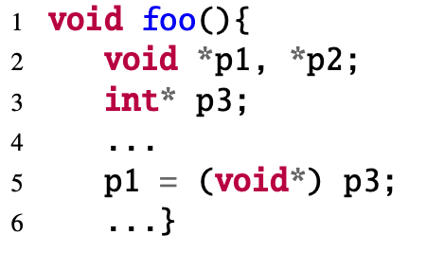
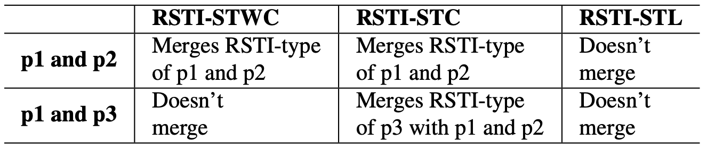
RSTI Enforcement details
Merging of Compatible Types for Casting
Depending on which mechanism is used and the pointer casts, different RSTI types can be combined or merged together.
This is showcased below.
Notes:
Depending on which mechanism is used and the pointer casts, different RSTI types can be combined or merged together. There are two basic types, void* and int*, but each RSTI mechanism distinguishes between them depending on the code. RSTI-STC merges types if there is a cast (Line 5), and thus both basic types would have one RSTI-type under RSTI-STC. RSTI-STWC doesn’t merge types with casts. However, since p1 and p2 have the same scope, type, and permission, they both will have one RSTI-type. RSTI-STL adds the location, and this allows it to distinguish p1, p2, and p3 with three RSTI-types. This distinction directly affects the number of instrumentations for each mechanism.

Slide 74





RSTI Implementation
LLVM Compiler pass
AArch64 Backend
Custom compiler pass for static analysis and instrumentation
(3017 LoC)
LLVM pass is executed in the AArch 64 Backend
RSTI P2P library
Library for pointer-to-pointer primitives
(487 LoC)
+Additional support
Link Time Optimization (LTO)
Notes:
Our prototype is built on top of Apple’s LLVM fork. It consists of 3504 lines of code (LoC), with 3017 LoC for the LLVM pass and 487 LoC for the pointer-to-pointer library. This includes all three mechanisms. The pointer-to-pointer library is integrated into LLVM’s compiler-rt. The LLVM pass executes on the IR level but is in the AArch64 backend. We apply a few optimizations to RSTI. First, is Link Time Optimization (LTO), which combines all the object files into one file. In addition to that, we execute the pass in the LTO phase. This allows RSTI to avoid unnecessary instrumentation. Executing the pass in the LTO phase, particularly after all the object files have been combined into one, is not only beneficial for performance reasons, but is important to help RSTI function properly and efficiently. Being able to have a full look at the program and analyze all the scope-type information at once, instead of doing it per object file, allows RSTI to completely map all the scope-type information for all the pointers accurately for the entire program.

Slide 75
RSTI Evaluation
We evaluate RSTI by answering the following questions:
How effective is RSTI in preventing state-of-the-art attacks as well as real-world attacks?
How secure is RSTI against abusing pointer-to-pointer metadata and pointers with the same RSTI-type?
How much performance overhead does RSTI impose in benchmarks and real-world programs?
Notes:
We evaluate RSTI by answering the following questions: How effective is RSTI in preventing state-of-the-art attacks as well as real-world attacks? How secure is RSTI against abusing pointer-to-pointer metadata and pointers with the same RSTI-type? How much performance overhead does RSTI impose in benchmarks and real-world programs?

Slide 76
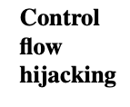
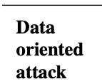
RSTI Security evaluation
RSTI can defend against both control-flow hijacking and data-oriented attacks, as well as real-world exploits.
Notes:
So let’s start first with the security evaluation. RSTI can defend against both control-flow hijacking and data-oriented attacks, as well as real-world exploits. This table shows an example of the variety of state-of-the-art attacks, the full table is in the paper and prelim document. We exercised RSTI against powerful synthesized attacks, such as NEWTON and DOP, as well as real-life exploits from the libtiff library. The main point here is that the original scope-type information changes when the gadgets and pointers are being abused by the attacker. This causes the RSTI type to change and thus the attack can be detected. This attack can only succeed if all dereferences and gadgets have the same RSTI-type. Thus RSTI offers a robust and wide protection against a variety of attacks.

Slide 77
RSTI Security evaluation
RSTI can defend against both control-flow hijacking and data-oriented attacks, as well as real-world exploits.
Notes:
So let’s start first with the security evaluation. RSTI can defend against both control-flow hijacking and data-oriented attacks, as well as real-world exploits. This table shows an example of the variety of state-of-the-art attacks, the full table is in the paper and prelim document. We exercised RSTI against powerful synthesized attacks, such as NEWTON and DOP, as well as real-life exploits from the libtiff library. So let’s explain two examples in detail. First, the NEWTON CsCFI attack. This is an attack on NGINX that calls and exploits mprotect. One of the attack steps is maliciously overwriting a function pointer (c->send_chain) in the function ngx_http_write_filter with a pointer to malloc. If the malloc pointer is in libc, then it won’t have a PAC on it, and thus authentication would fail. Moreover, if we assume that both the function pointer and the malloc pointer are protected by RSTI, then authentication would still fail due to both having different types (void*(size_t size) and ngx_send_chain_pt), as well as being in different scopes. Thus, RSTI detects this attack. Second is the DOP ProFTPd attack. This is a Data Oriented Programming attack [36] which corrupts the first known pointer of struct ssl_ctx in a loop and overwrites it with 8 malicious dereferences, relying on 4 gadgets for each dereference. Since these dereferences invoke load gadgets, these gadgets are protected by RSTI, and thus cannot be invoked maliciously without conforming to the RSTI-type. This load gadget corrupts &ServerName with data from resp_buf. However, &ServerName and resp_buf have different RSTI-types as shown in the table. &ServerName is of type const char* and its scope is core_display_file, while resp_buf is of type char* with scope pr_response_send_raw. Since RSTI protects data pointers with RSTI-type, RSTI detects this attack. This attack can only succeed if all dereferences and gadgets have the same RSTI-type. Thus RSTI offers a robust and wide protection against a variety of attacks.

Slide 78
Analysis on RSTI instrumentation: Equivalence Class
Equivalence Class of Type (EC_{T}): We refer to the number of basic types in each RSTI-type as Equivalence Class of Type (EC_{T}).
Equivalence Class of Variable (EC_{V}): We refer to the number of variables in each RSTI-type as Equivalence Class of Variable (EC_{V}).
Notes:
Now we want to showcase the usefulness of the RSTI-type information, particularly how unique RSTI-types are for each RSTI-mechanism. First, we have Equivalence Class of Type (ECT): RSTI-STWC has the advantage of having only one basic type for each RSTI-type, whereas RSTI-STC can have more than one basic type in an RSTI-type, due to the combining. We refer to the number of basic types in each RSTI-type as Equivalence Class of Type (ECT). We use the term equivalence class since this count provides a measure of how viable pointer substitution attacks can be within an application. The same term is used in CFI papers and RSTI is the first, as far as we know, to adopt it for data pointers. • Equivalence Class of Variable (ECV): RSTI-STWC has a maximum ECT of 1, due to there being only one type in each RSTI-type. However, RSTI-STWC does not have one variable for each RSTI-type. Several variables can be declared within the same RSTI-type. We refer to the number of variables in each RSTI-type as Equivalence Class of Variable (ECV).The largest ECV for RSTI-STL is always 1, due to the inclusion of the location (&p) in the modifier, while the largest ECV for RSTI-STWC would vary. I have done a full analysis on these numbers, but I won’t go into them now due to time constraints. However, I can show them if needed.

Slide 79
Analysis on RSTI instrumentation
Pointer-to-pointer data from SPEC 2006
The intuition was that this exact case of losing the original type of the pointer when a pointer-to-pointer is casted and passed as an argument to a function is rare.
And this was confirmed by the analysis of SPEC 2006. There is a total of 7489 sites across the benchmarks where a pointer-to-pointer is passed or loaded. Of those, only 25 meet the special criteria where the original type could be lost.
Notes:
I previously explained the exact use case of pointer-to-pointer handling. The intuition was that this exact case of losing the original type of the pointer when a pointer-to-pointer is casted and passed as an argument to a function is rare. And this was confirmed by the analysis of SPEC 2006. There is a total of 7489 sites across the benchmarks where a pointer-to-pointer is passed or loaded. Of those, only 25 meet the special criteria where the original type could be lost.

Slide 80
RSTI Performance evaluation
Evaluations were run on the Apple Mac Mini M1 which supports the ARMv8.4 architecture and ARM PA. It has 4 small cores, 4 big cores, and 8GB DRAM.
The prototype was implemented on Apple’s LLVM fork. All applications were compiled with LTO and O2 for fair comparison.
All C programs were run with real PA instructions.
For C++ programs:
A correctness test was done on ARM’s Fixed Virtual Platform (FVP).
Seven XOR (eor) instructions were used as an equivalent to one PA instruction.
This has been measured and confirmed in previous works
Notes:
So let’s talk about performance now. Evaluations were run on the Apple M1, which supports the ARMv8.4 architecture and ARM PA. We used an Apple Mac Mini M1, that has 4 small cores, 4 big cores, and 8GB DRAM. Our prototype was implemented on Apple’s LLVM fork. We compiled all the applications with LTO and O2 for fair comparison. All our C programs were run with real PA instructions. We were able to disable Apple’s use of PA to avoid any conflicts that would happen between RSTI’s and Apple’s PA instrumentation. Whilst evaluating C++ programs, we discovered that PA instructions are built into Apple’s standard C++ library. Thus, we were not able to turn them off. So, for C++ applications, we first did a correctness test on ARM’s Fixed Virtual Platform (FVP). Then, in order to emulate the performance overhead of the PA instructions, we used seven XOR (eor) instructions as an equivalent to one PA instruction on the Mac Mini M1. This has been measured and confirmed in previous works

Slide 81
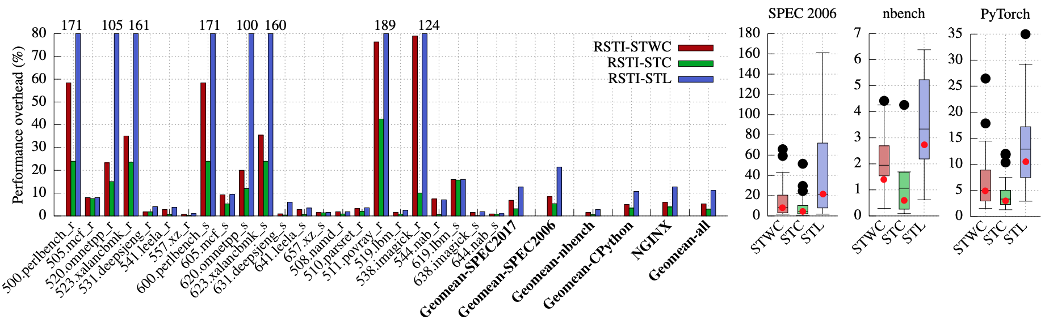
RSTI Performance evaluation
A wide variety of benchmarks to showcase RSTI’s versatility, namely: SPEC CPU 2006, SPEC CPU 2017, and nbench, in addition to PyTorch and NGINX
The total geometric mean across all the benchmarks and applications is 5.29%, 2.97% and 11.12% for RSTI-STWC, RSTI-STC and RSTI-STL, respectively.
Notes:
For the performance evaluation, a wide variety of benchmarks was used to showcase RSTI’s versatility, namely: SPEC CPU 2006, SPEC CPU 2017, and nbench. We also evaluated NGINX, a real-world application with RSTI on the Apple M1. We also evaluated CPython3.9, and evaluated PyTorch benchmarks to test how RSTI would perform if used in a machine learning context. As can be seen, the RSTI mechanisms generally have mild overhead. Some exceptions are there for RSTI-STL, where performance overhead can exceed more than 100%. This is still comparatively lower to other defense mechanisms such as DFI, which has an average overhead of around 106%, and YARRA, which has an average overhead of 400%-600% when protecting the whole program. However, real programs, such as NGINX and PyTorch, have a reasonable overhead. The total geometric mean across all the benchmarks and applications is 5.29%, 2.97% and 11.12% for RSTI-STWC, RSTI-STC and RSTI-STL, respectively. Thus, the RSTI mechanisms can be effectively used to secure machine learning and real-life applications

Slide 82
RSTI Performance evaluation
CPython3.9 PyTorch geometric mean is 5.01%, 3.44% and 10.80% for RSTI-STWC, RSTI-STC and RSTI-STL, respectively.
SPEC 2006 geometric mean is 8.42%, 5.36% and 21.47% for RSTI-STWC, RSTI-STC and RSTI-STL, respectively.
Pearson correlation factor of 0.75 - 0.8.
Notes:
Taking a look at just the PyTorch benchmarks, we see that the geometric mean is 5.01%, 3.44% and 10.80% for RSTI-STWC, RSTI-STC and RSTI-STL, respectively. This shows that RSTI can be practical for machine learning applications.
Also, to give an idea on the correlation of the results, the SPEC 2006 benchmarks have a geometric mean of 8.42%, 5.36%, and 21.47% for RSTI-STWC, RSTI-STC, and RSTI-STL, respectively. We analyzed the instrumentation and found the performance overhead is highly correlated with the number of instrumented loads/stores, with a Pearson correlation factor of 0.75-0.8.

Slide 83
Discussion
Matching scope-type information.
Is the PAC length enough?
Protecting return addresses.
Notes:
So let’s discuss some possible limitations and interesting discussion points. There are cases where pointers could have the same RSTI-type. Since RSTI needs to maintain program semantics, distinguishing between pointers that have the same RSTI-type is hard statically. However, it is not practically feasible for an attacker to maintain the same RSTI-type when executing an attack, as can be seen in our security evaluation. Then, is the PAC length enough? In macOS, and in our setting, the PAC length is 16 bits, with the exception of pointer-topointer where the PAC length is 8 bits. This means that, for 16 bits, there are 65,536 possible PACs, which is sufficient for most practical cases. Prior work has shown that real-life applications, such as NGINX and Apache usually have around 25,000 live objects on average. Thus, there is more than enough PAC combinations. Finally, in regards to protecting return addresses, The use of scope-type information to protect return addresses is not as powerful as using it to protect pointers. There are many practical and strong defenses that protect return addresses, and this is considered orthogonal RSTI. RSTI can be deployed alongside other return address protections. For example, in our evaluations, we turn on the default Apple return address protection scheme, so we do take return address protection overhead into consideration.

Slide 84
Conclusion
Scope-Type Integrity (STI) is a new defense policy that enforces a pointer to conform to the programmer’s intended usage by utilizing scope, type and permission information and bringing that information back to leverage during runtime.
Runtime Scope-Type Integrity (RSTI) is a robust and efficient security mechanism that protects all pointers in a program by leveraging ARM Pointer Authentication to enforce STI.
Three RSTI defense mechanisms with varying levels of security granularity, enforcing control-flow and data-flow integrity.
Showcased the security of RSTI against state-of-the-art attacks, and demonstrated its low performance overhead across a variety of benchmarks and real-life applications.
Notes:
So to conclude this contribution, I introduced Scope-Type Integrity (STI), a new defense policy that enforces a pointer to conform to the programmer’s intended usage by utilizing scope, type and permission information and bringing that information back to leverage during runtime. We presented RSTI, a robust and efficient security mechanism that protects all pointers in a program by leveraging ARM Pointer Authentication. RSTI enforces STI to ensure that each pointer conforms to its scope, type, and permission that was originally intended by the programmer. RSTI brings back this information to the runtime. We implemented three RSTI defense mechanisms with varying levels of security granularity, enforcing control-flow and data-flow integrity. We showcased the security of RSTI against state-of-the-art synthesized and real attacks, and demonstrated its low performance overhead across a variety of benchmarks and and real-life applications. This paper is currently under submission at ASPLOS 2024

Slide 85
Outline
Motivation
Background
Present Contributions
Future Work
Speculative execution memory corruption attacks
Pointer Authentication based Spectre defense
Security and Memory Safety in Energy Harvesting
Summary
Notes:
That wraps up our discussion of the contributions for this preliminary thesis
I will now propose the future work I wish to complete for this thesis

Slide 86

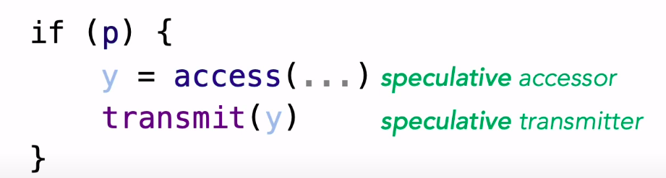

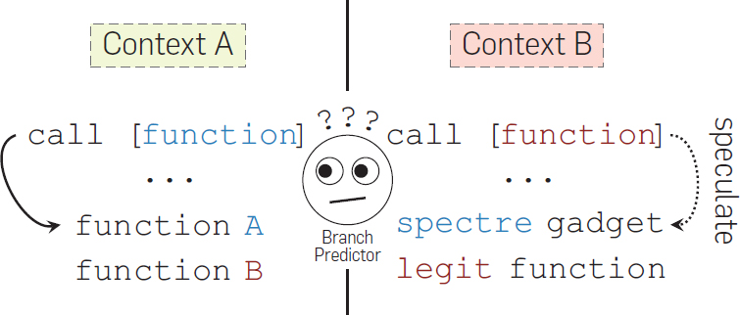
Future work
Speculative Execution memory corruption attacks
Notes:
So we have seen how hardware security features such as Pointer Authentication can be used to protect a variety of pointers within an application with the PACTight and RSTI defense mechanisms that cover control and data flow deviations. But what if there is an attack that doesn’t violate them in the program itself? A new class of attacks that have emerged recently and are becoming more prevalent are transient execution attacks, particularly speculative execution attacks. These are attacks that cause the program to speculatively perform certain operations that would not be executed if the program was executing correctly. The results of this execution would then be leaked via side channels, such as the cache, that the attacker can observe. The main issue with PACTight and RSTI is that they rely on the effects of the attack actually being visible in memory, and do not take account for speculative execution. PACTight relies on an external metadata that gets updated only when instructions are actually executed, and RSTI doesn’t have a dynamic metadata, and thus the attacker can correctly execute the instructions and leak data speculatively if they want. This means that a new mechanism is needed to combat these attacks.

Slide 87
Future work
Pointer Authentication based Spectre defense (Ongoing discussion):
Combine Pointer Authentication with lfences. lfences are instructions that prevent speculative execution.
Instrumenting all pointers with pointer authentication instructions, similar to RSTI.
However, the load instruction to the sensitive data would be isolated via programmer annotation and given its own unique modifier and an lfence instruction added to it.
Another avenue of that is being investigated is possible defenses against speculative execution attacks in Rust.
Notes:
We propose to still use Pointer Authentication for defending, but to combine that with lfences. lfences are instructions that prevent speculative exection from happening until the lfence instruction has been executed. In order for the attacker to execute a speculative execution attack, the attacker needs a speculative gadget, which would usually be a load instruction of a pointer to the sensitive data that exists inside an if statement. This proposal proposes instrumenting all pointers with pointer authentication instructions, similar to RSTI. However, the load instruction to the sensitive data would be isolated via programmer annotation and given its own unique modifier and an lfence instruction added to it. In this way, the attacker cannot abuse that instruction, and if the attacker tries to use another load instruction, that load instruction is protected with pointer authentication. There is still an ongoing discussion on the viability of this design approach, and there is extensive investigation on how this can be done.
Another avenue of that is being investigated is possible defenses against speculative execution attacks in Rust. A paper called SPEAR proposes a speculative execution attack against Rust that speculatively violates Rust’s bound checking mechanism. This is important, since one of Rust’s main features is its memory safety and prevention of memory corruption attacks that have plagued C/C++. Preventing this type of attack would be an important contribution.

Slide 88
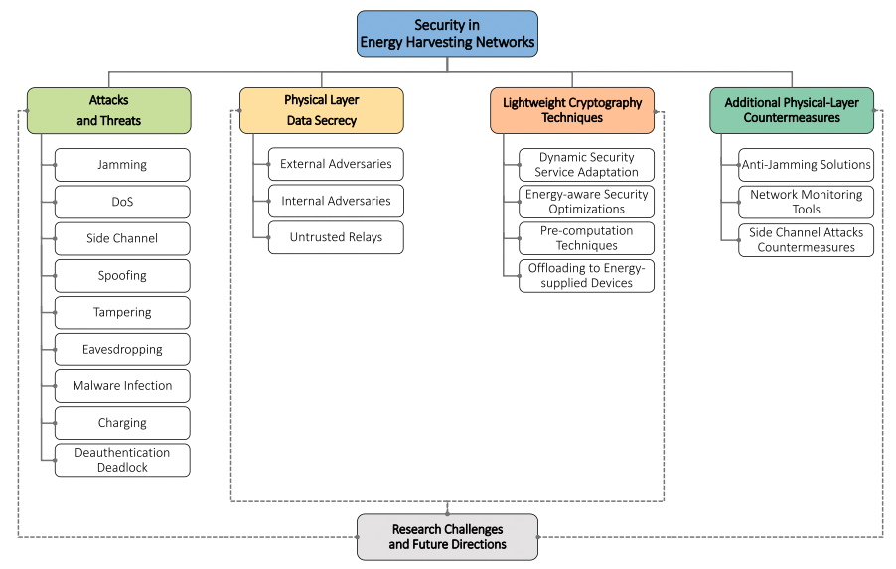
Future work
Security and Memory safety in Energy Harvesting:
Energy harvesting processes
Energy harvesting capabilities are appealing for a variety of applications, such as Wireless Body Area Networks (WBANs) and IoT.
Notes:
In addition to that, I also am working on security and memory safety in energy harvesting. Energy Harvesting (EH) processes refer to the set of techniques used to capture electrical energy from ambient sources, thanks to dedicated conversion circuits, to be used to extend the lifetime of battery-powered wireless devices. Since these devices need to be as efficient as possible, there exists very little research on the possible security implications, especially in regards to memory safety. I conducted a survey on the security in energy harvesting, highlighting possible attacks and security risks. One example is eavesdropping, since EH networks are usually deployed without any built-in encryption mechanism, this exposes the delivered energy and information to eavesdropping attacks. Work is being done currently in collaboration with Purdue and Stony Brook to look for possible critical attack avenues and possible defenses.

Slide 89
Outline
Motivation
Background
Present Contributions
Future Work
Summary
Notes:
That concludes the future work, and now I’ll summarize

Slide 90
Summary of Research
Design practical and efficient defense mechanisms against control-flow hijacking, data-oriented and speculative execution attacks.
Utilization of hardware security features.
Past work: PACTight
Three pointer integrity properties
Completely prevent control-flow hijacking attacks
Low runtime overhead with high security guarantees
RSTI Key Contributions
Bring back the programmer’s intent to the runtime.
Protect all pointers in a program.
Low runtime overhead with high security guarantees
Notes:
This thesis presents research projects that utilize hardware security features to design practical and efficient defense mechanisms against control-flow hijacking, data-oriented and speculative execution attacks.
This proposal discussed prior work, PACTight, an efficient and robust mechanism to guarantee pointer integrity using ARM’s Pointer Authentication mechanism. We identified three security properties PACTight enforces to ensure pointer integrity. Also, this proposal introduced Scope-Type Integrity (STI), a new defense policy that enforces a pointer to conform to the programmer’s intended usage by utilizing scope, type and permission information and bringing that information back to leverage during runtime. Both mechanisms offer relatively low overhead and high security guarantees. Finally, I also introduced a new direction for utilizing hardware security features to protect programs from speculative execution attacks.

Slide 91
Summary of Research
Publications:
Tightly Seal Your Sensitive Pointers with PACTight
Mohannad Ismail, Andrew Quach, Christopher Jelesnianski, Yeongjin Jang, Changwoo Min
In Proceedings of the 31st USENIX Security Symposium (USENIX Security 2022)
Enforcing C/C++ Type and Scope at Runtime for Control-Flow and Data-Flow Integrity
Mohannad Ismail, Christopher Jelesnianski, Yeongjin Jang, Changwoo Min, Wenjie Xiong
Under submission at the 29th ACM Conference on Architectural Support for Programming Languages and Operating Systems (ASPLOS 2024)

Slide 92
Summary of Research
Other Publications:
Protect the System Call, Protect (Most of) the World with BASTION
Christopher Jelesnianski, Mohannad Ismail, Yeongjin Jang, Dan Williams and Changwoo Min
In Proceedings of the 28th ACM International Conference on Architectural Support for Programming Languages and Operating Systems (ASPLOS 2023)
VIP: Safeguard Value Invariant Property for Thwarting Critical Memory Corruption Attacks
Mohannad Ismail+, Jinwoo Yom+, Christopher Jelesnianski, Yeongjin Jang, and Changwoo Min
In Proceedings of Conference on Computer and Communications Security (CCS 2021)
Witcher: Systematic Crash Consistency Testing for Non-Volatile Memory Key-Value Stores
Xinwei Fu, Wook-Hee Kim, Ajay Paddayuru Shreepathi, Mohannad Ismail, Sunny Wadkar, Dongyoon Lee, and Changwoo Min
In Proceedings of ACM Symposium on Operating Systems Principles (SOSP 2021)
POSEIDON: Safe, Fast and Scalable Persistent Memory Allocator
Anthony Demeri, Wook-Hee Kim, R. Madhava Krishnan, Jaeho Kim, Mohannad Ismail, and Changwoo Min
In Proceedings of the 12th Annual Non-Volatile Memories Workshop (NVMW 2021)
POSEIDON: Safe, Fast and Scalable Persistent Memory Allocator
Anthony Demeri, Wook-Hee Kim, R. Madhava Krishnan, Jaeho Kim, Mohannad Ismail, and Changwoo Min
In Proceedings of the 21st ACM/IFIP International Middleware Conference (Middleware 2020)

Slide 93
Summer internship experience
Intern, Member Of Technical Staff
VMware
Member of the ESXi-ARM team
Dates Employed: May 2021 – Aug 2021
Intern, Member Of Technical Staff
VMware
Return offer, Member of the ESXi-ARM team
Dates Employed: May 2022 – Aug 2022
Intern, Software Engineer
Apple
Member of the security team at the Vision Products Group (VPG)
Dates Employed: May 2023 – Aug 2023

Slide 94
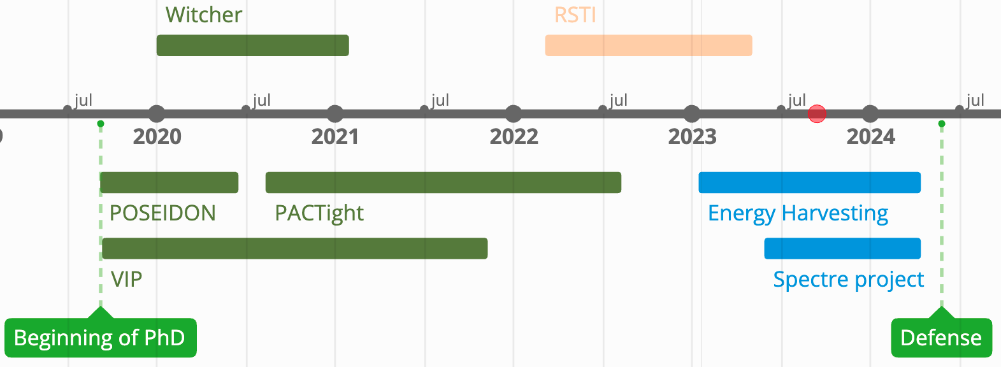
Timeline from start to anticipated graduation
Completed and published
Completed and under submission
In progress

Slide 95
Timeline for the Spectre project
Idea and design
June 2023 - October 2023
Implementation and early evaluation
Late October 2023 - Late January 2024
Evaluation and Bug fixing
February 2024 - March 2024
Writing and defense
Early March 2024 - Late April 2024

Slide 96
Expected dissertation outline
Introduction
Motivation
Contributions
Background
Memory corruption attacks
ARM Pointer authentication
Current defenses
Past work: PACTight
Runtime Scope Type Integrity
Spectre defense mechanism
Security in Energy-Harvesting Systems
Conclusions

Slide 97
Effective and Practical Defenses Against Memory Corruption and Transient Execution Attacks with Hardware Security Features
Thank you!
Mohannad Ismail
Questions?
Notes:
Thank you for your attention.
This brings the presentation to a close and I am now ready for questions.

Slide 98
Backup Slides

Slide 99
But why not use memory-safe languages?
C and C++ are memory unsafe languages, and their semantics are the root of the memory safety issues
There’s a debate that has been going for some time on whether or not to keep using them.
Many are proposing to switch to memory safe languages such as Rust.
But it isn’t that simple.

Slide 100

C/C++ is here to stay.
Performance

Slide 101

C/C++ is here to stay.
Performance
Communication.

Slide 102
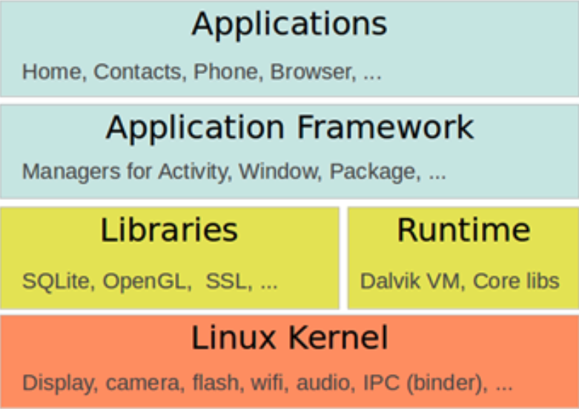
C/C++ is here to stay.
Performance
Communication.
Completeness.

Slide 103

C/C++ is here to stay.
Performance
Communication.
Completeness.
Maturity

Slide 104

C/C++ is here to stay.
Performance
Communication.
Completeness.
Maturity
Legacy code

Slide 105

C/C++ is here to stay.
Performance
Communication.
Completeness.
Maturity
Legacy code
Type safe languages still rely on unsafe libraries

Slide 106
PACTight Design: Enforcing the properties
Unforgeability: The PAC mechanism includes the pointer as one of the inputs to generate the PAC. If the pointer is forged, it will be detected at authentication.
Pointer
Object
Forged Pointer
Object
Another object
Pointer (p)
Forged Pointer (q = corrupted p = execve)
Authenticate
Authenticate
Address
PAC
Address
execve
PAC
execve
0x2
Modifier
&p ⨁ tag(p)
Modifier
&q ⨁ tag(q)
Object
Another object
Notes:
Starting with unforgeability, the PAC mechanism on itself includes the pointer as one of the inputs to generate the PAC. Thus a forged pointer would trigger a fault on authentication, due to the pointer having a different value from the one that was used for that PAC.

Slide 107
PACTight Design: Enforcing the properties
Non-dangling: PACTight uses a random tag to track the lifecycle of a memory object. The lifecycle of a PACTight-sealed pointer is bonded to that of the object.
Pointer
Freed object
Pointer
Object
or
Pointer
Realloc’d object
Pointer (p)
Dangling Pointer (freed p)
Authenticate
Authenticate
Address
PAC
Address
Address
PAC
Address
0x2
Modifier
&p ⨁ tag(p)
Modifier
&p ⨁ tag(p)
INVALID TAG!
Object
Freed object
Notes:
For the sake of time, I will only explain how one of the properties is enforced in detail but I can show the others if needed. To enforce the non-dangling property, PACTight assigns a random tag to the pointer. This random tag is generated upon allocation and changes when an object is freed or reallocated, thus allowing the lifecycle of the object to be tracked. A dangling pointer being used will not have a tag, and thus the PAC generated on authentication will not match, resulting in a violation, and thus preventing any misuse of dangling pointers.

Slide 108
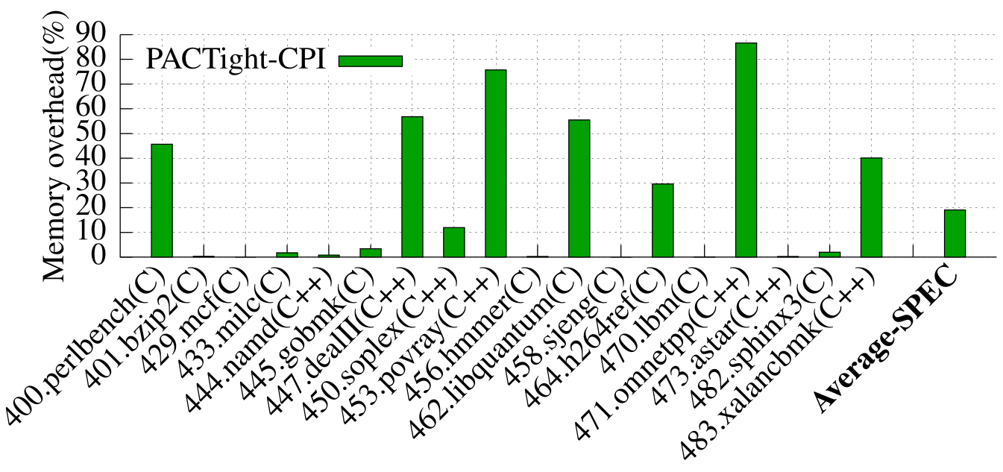
Evaluation: Memory overhead
We ran the SPEC benchmarks with the PACTight-CPI protection:
19% memory overhead on average.
Notes:
We also evaluated the memory overhead of PACTight-CPI on the SPEC benchmarks and got a 19% memory overhead on average.

Slide 109
Data oriented attacks are becoming more sophisticated!
Data-oriented attacks are dangerous memory corruption attacks
SSL_CTX * ssl_ctx
BIGNUM * d1
BN_ULONG * d2
struct cert_st * cert
struct rsa_st * rsa
Private Key
CERT_PKEY * key
EVP_PKEY* privatekey
Data-oriented Programming (DOP) Attack
Notes:
Here I will introduce two attacks based on violating memory safety: Control flow hijacking and use-after-free attacks. Control-flow hijacking attacks aim to maliciously change the legitimate control-flow of a program. This can be done by corrupting indirect calls or jumps, or return addresses. This allows the adversary to execute an illegitimate control-flow transfer, that can reach, for example, a system call. Use-after-free attacks are temporal attacks aimed to exploit the incorrect use of dynamic memory. A pointer is allocated on the heap and can be used by the program. When the memory is freed, the pointer becomes dangling and can be exploited by an attacker.

Slide 110
RSTI: Design philosophy
The goal of the defense mechanisms is ensuring correct and proper execution of a program.
Meanwhile, the developer of the program has put much information whilst they were writing the program to make sure that it executes in a certain way.
All this information is, unfortunately, lost at runtime.
So why not use this information as the security context that we need, and propagate it to the runtime in some way?
If we can ensure that the program executes in the way that the developer intended even when an attacker is present, then the program would not be compromised, since an attacker relies on the anomalous execution of a program by exploiting vulnerabilities.

Slide 111
RSTI: Extracting scope, type and permission
Type
Notes:
The variable cp is defined with a type of void*. Its scope is the function main. It has read-only permissions, due to the const. By examining the debug metadata, we can traverse it to get the type, as shown here in Line 6 of the LLVM IR debug info

Slide 112
RSTI: Extracting scope, type and permission
Scope
Notes:
We can also traverse it to get the scope, as shown here in Line 4 of the LLVM IR debug info

Slide 113
RSTI: Extracting scope, type and permission
Permission
Notes:
And we can get the permission, as shown here in Line 8 of the LLVM IR debug info. Permission is represented by using const in the variable definition.

Slide 114
RSTI defense mechanisms
We propose three RSTI defense mechanisms, each with its own distinct view of the RSTI-type
RSTI-STWC (Scope-Type Without Combining) authenticates and re-signs pointers when casts happen.
RSTI-STC (Scope-Type with Combining) combines compatible types together so that it wouldn’t need to re-sign pointers when pointer casts happen.
RSTI-STL (Scope-Type with Location) combines the location, i.e., address, of the pointer (&p) with the scope-type information.
Notes:
We propose three RSTI defense mechanisms, each with its own distinct view of the RSTI-type. RSTI’s three security mechanisms have different security guarantees due to the different nature and strictness each mechanism has to offer. I will start by defining them and then will show an example to clarify them. RSTI-STWC (Scope-Type Without Combining) is our main RSTI mechanism. RSTI-STWC authenticates and re-signs pointers when casts happen. RSTI-STC (Scope-Type with Combining) combines compatible types together so that it wouldn’t need to re-sign pointers when pointer casts happen. RSTI-STL (Scope-Type with Location) is the strictest RSTI defense mechanism. It combines the location, i.e., address, of the pointer with the scope-type information to completely prevent any pointer substitution attacks. This means that the pointer can only be used legitimately at that specific location.

Slide 115
RSTI defense mechanisms
Notes:
So what exactly does this entail? So this figure shows code instrumented with the three mechanisms and the corresponding RSTI-types. For RSTI-STWC, in Figure a, there are two basic types in the program (void* and ctx*). Due to RSTI-STWC’s analysis considering scope and permission, there are now three RSTI-types, M1, M2 and M3. Even though there is a cast between void* and ctx*, RSTI-STWC maintains separate RSTI-types for them. RSTI-STWC makes sure that legitimate casts are handled appropriately by re-signing the PAC with the RSTI-types after casting, as in Lines 19-21 in Figure a. For RSTI-STC, in Figure b, ctx* and void* are combined into one RSTI-type, and thus there is no need for additional instrumentation to handle them in Lines 5-10. RSTI-STC has less security guarantees but offers better performance. For RSTI-STL, in Figure c, each usage of the pointer in a different location has its own RSTI-type. So, in addition to instrumenting casts, RSTI-STL re-signs any pointers that get passed as arguments, due to a change in the location of the pointer. Anytime the location of the pointer changes, RSTI-STL authenticates and re-signs within the new location. This allows it to overcome the shortcomings of the others, albeit at a higher performance cost due to a higher number of instrumentations. There is a full performance evaluation on these three mechanisms in the coming slides.

Slide 116
RSTI Enforcement details: Pointer-to-pointer handling
Not all pointer-to-pointer types are covered. Only ones that are lost when the pointer type goes out of scope, (e.g., being casted and passed as a function argument) and thus cannot be statically detected.
The IR provides sufficient information to handle pointer-to-pointer cases that do not fall into this category. Thus, we do not need to instrument every pointer-to-pointer with this mechanism.
RSTI uses a runtime library to handle pointer-to-pointer. Its functions are:
pp_add: This is called when a casted double pointer function argument is detected. It adds the FE to the metadata along with its RSTI-type.
pp_sign: This is called before a store of a casted double pointer function argument. It signs the pointer with a PAC based on the RSTI-type and metadata
pp_auth: This is called before a load of a signed casted double pointer. It authenticates that pointer with the RSTI-type and the original type obtained from the metadata
pp_add_tbi: This is called following pp_sign. It adds the CE to the top bits of the pointer so that they can be used to obtain the original type
Notes:
Not all pointer-to-pointer types are covered. Only ones that are lost when the pointer type goes out of scope, (e.g., , being casted and passed as a function argument) and thus cannot be statically detected. While there are different pointer-to-pointer scenarios, few pointer-to-pointers fall into this specific category. The IR provides sufficient information to handle pointer-to-pointer cases that do not fall into this category. Thus, we do not need to instrument every pointer-topointer with this mechanism. Since the CE can only be 8 bits, this means that only 256 types can be used. This is shown to be sufficient in the evaluation section.

Slide 117
Analysis on RSTI instrumentation: Equivalence Class
Equivalence Class of Type (EC_{T}): We refer to the number of basic types in each RSTI-type as Equivalence Class of Type (EC_{T}).
Equivalence Class of Variable (EC_{V}): We refer to the number of variables in each RSTI-type as Equivalence Class of Variable (EC_{V}).
Notes:
Now we want to showcase the usefulness of the RSTI-type information, particularly how unique RSTI-types are for each RSTI-mechanism. First, we have Equivalence Class of Type (ECT): RSTI-STWC has the advantage of having only one basic type for each RSTI-type, whereas RSTI-STC can have more than one basic type in an RSTI-type, due to the combining. We refer to the number of basic types in each RSTI-type as Equivalence Class of Type (ECT). We use the term equivalence class since this count provides a measure of how viable pointer substitution attacks can be within an application. The same term is used in CFI papers and RSTI is the first, as far as we know, to adopt it for data pointers. • Equivalence Class of Variable (ECV): RSTI-STWC has a maximum ECT of 1, due to there being only one type in each RSTI-type. However, RSTI-STWC does not have one variable for each RSTI-type. Several variables can be declared within the same RSTI-type. We refer to the number of variables in each RSTI-type as Equivalence Class of Variable (ECV).The largest ECV for RSTI-STL is always 1, due to the inclusion of the location (&p) in the modifier, while the largest ECV for RSTI-STWC would vary. I have done a full analysis on these numbers, but I won’t go into them now due to time constraints. However, I can show them if needed.

Slide 118
Analysis on RSTI instrumentation: Equivalence Class
Now we want to showcase the usefulness of the RSTI-type information. We define some terminology first:
Number of types in program (NT): This is the number of basic types a program has, such as int*, void*, etc.
Number of RSTI-types (RT): This refers to the actual types that are enforced by the specific RSTI mechanism.
Equivalence Class of Type (EC_{T}): We refer to the number of basic types in each RSTI-type as Equivalence Class of Type (EC_{T}).
Equivalence Class of Variable (EC_{V}): We refer to the number of variables in each RSTI-type as Equivalence Class of Variable (EC_{V}).
Notes:
Now we want to showcase the usefulness of the RSTI-type information. We define some terminology first: Number of types in program (NT): This is the number of basic types a program has, such as int*, void*, etc, Number of RSTI-types (RT): This refers to the actual types that are enforced by the specific RSTI mechanism. Equivalence Class of Type (ECT): RSTI-STWC has the advantage of having only one basic type for each RSTI-type, whereas RSTI-STC can have more than one basic type in an RSTI-type, due to the combining. We refer to the number of basic types in each RSTI-type as Equivalence Class of Type (ECT). We use the term equivalence class since this count provides a measure of how viable pointer substitution attacks can be within an application. The same term is used in CFI papers and RSTI is the first, as far as we know, to adopt it for data pointers. • Equivalence Class of Variable (ECV): RSTI-STWC has a maximum ECT of 1, due to there being only one type in each RSTI-type. However, RSTI-STWC does not have one variable for each RSTI-type. Several variables can be declared within the same RSTI-type. We refer to the number of variables in each RSTI-type as Equivalence Class of Variable (ECV).The largest ECV for RSTI-STL is always 1, due to the inclusion of the location (&p) in the modifier, while the largest ECV for RSTI-STWC would vary.

Slide 119
Analysis on RSTI instrumentation: Equivalence Class
Notes:
So going back to these tables that show the different RSTI-Types, ….

Slide 120
Analysis on RSTI instrumentation: Equivalence Class
Notes:
… we can see that for this example, the largest Equivalence class of type is 2, due to two basic types being merged together.

Slide 121
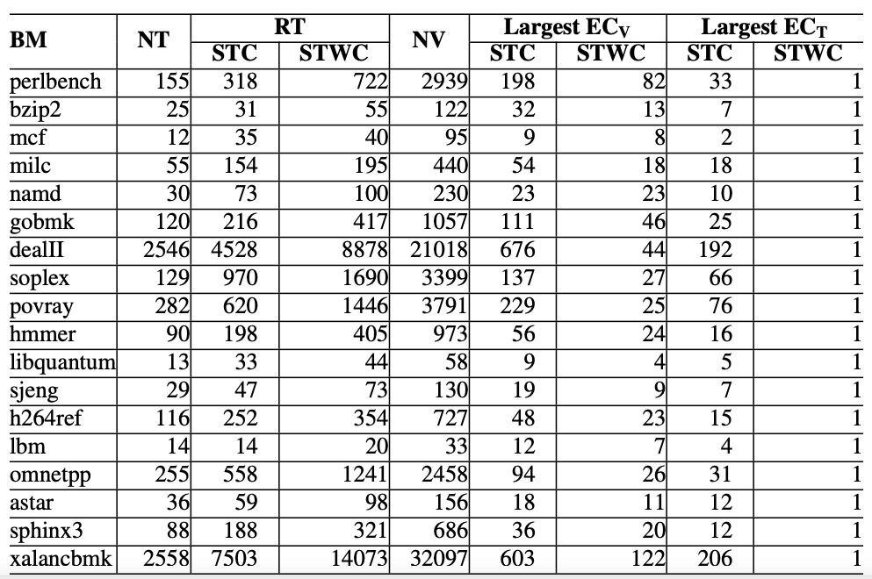
Analysis on RSTI instrumentation: Equivalence Class
Notes:
This table shows the EC data for SPEC CPU2006. RSTI increases the number of types that can be distinguished in a program. Also, the impact of combining RSTI-types for RSTI-STC reduces the number of RSTI-types in the mechanism, but is still higher than the number of types without RSTI. RSTI-STL is not shown in the table. This is because the largest ECT and ECV for RSTI-STL are always 1, due to the enforcement of the location. RSTI-STL is the most secure, however RSTI-STWC does still provide security value due to its ECT being always 1, and significantly reducing ECV.

